Slide 1
Homework: Dark Photon LDRD/ER Plan
—a list of all major technical tasks that need to be completed between now and collection of data (procurements, assemblies, reviews, installations, commissioning, milestones)
—for each task, give the estimated schedule for that task (best would be a project-like format showing interdependencies of things)
—for each task, the resources needed and currently identified (people), the cost estimated for each task
—specifically point out if there is anything that could occur more quickly with more resources (people or funds)
Also, a sensitivity plot that you could produce if you collected data from March-July, which we understand would result in a smaller data set than was used for the sensitivity plot that we were shown at the review. Along with this, give us an idea of how to scale the plot for shorter run times.

Slide 2
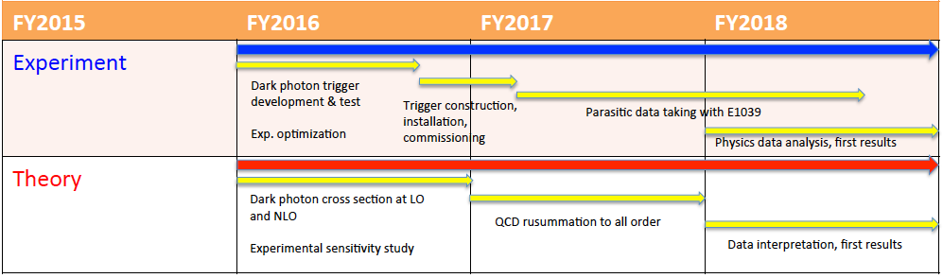
LDRD Tasks & Schedules
FY16: Accomplished all milestones and more!
QCD resummation to all orders
Today, good work in progress

Slide 3
FY17 Timeline: Hardware Effort
Nov
Dec
Jan
Feb
Mar
Apr---Jul
DAQ
Upgrade
V1495 trigger algo implementation & Integration into DAQ
Trigger
Commissioning with data
Offline analysis
Data taking,
Offline analysis
80/20 frame assembly
@LANL
trigger detector assembly & Fermilab safety review
@FNAL
SiPM readout
Integration;
Manpower:
Kun, PD(Sho), Ming, Student/Alex, Fermilab student/Engineer/collaboration
Hubert, Pat, Ming, PD, Alex, Fermilab student/E906 collaboration
Additional Engineer & Tech support (w/ $$) could help to reduce the schedule risk

Slide 4
FY-17 DAQ & Trigger Module V1495 Integration and Commissioning
DAQ upgrade
  By the end of November
V1495 and DAQ integration
  By mid Feb 2017
Commissioning
  By mid March 2017
Data taking
  April – July 2017
Manpower
  Kun, PD (Sho), Ming, Alex, Pat and help from E906 collaboration and other postdocs

Slide 5
FY-17 Trigger Detector Construction & Installation
Timeline:
  Complete and installed by mid of January 2017
All major hardware in hand
  Scintillators (at Fermilab)
  WLSF (at LANL)
  All 80/20 Al frames at LANL
    4 frames completed, 4 more (identical) to go
Frames assembled at LANL, ship to Femrilab for final assembly in December-January 2016
Fermilab mechanical structure safety review before installation
  Kenney to help ?
  Hubert, Ming
  By mid of Jan 2017
Lead people: Hubert, Ming, PD and help from Collaboration at Fermilab

Slide 6
SiPM readout and Services
Fermilab premap cards production
  Cost: 600 x $40 = $24K
  By mid January 2017
Discriminator and LV/HV PS
  LeCroy 4413 and NIM crates available from Fermilab pool
  Tested by the end of December
  Reuse Fermilab HV PS and the 48-ch distribution cards (50~60V, I <500 x 10uA )
Cables
  Recycle from previous Fermilab experiments
    Lemo cables, 550
    34-ch ribbon cables
    By mid of January 2017
V1495 and VME crate and Controller CPU
  In hand, need to update firmware based on E906 trigger code
  Integration starts early December, complete by mid Feb 2017
New Taiwan TDCs
  Being produced in Taiwan
  available by the end of March 2017, partial delivery possible
  Good to have items, but not absolutely needed for trigger
People
  Ming, PD/Sho, Kun, Pat and Collaboration

Slide 7
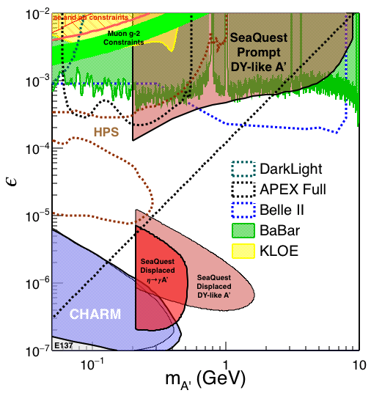
Updated Sensitivity from the Expected the E906 2017 Trial Run
April – July 2017, assuming 4-month (120 days) of parasitic running
For prompt-DY-like dark photon search, the lowest 𝜺 reach is proportional to 1/sqrt(Lumi) (Lumi, the integrated luminosity)
For displaced dark photon search, the case is more complicated:
  The upper limit is primarily limited by the decay length (kinematics) as most data statistics will be in this region, and not very sensitive to the change of statistics
  The lower bound is primarily limited by the cross section/statistics and thus is proportional to 1/sqrt(Lumi)

Slide 8
FY-17 Plan: Summary
Complete DAQ and Trigger upgrade for E906 Run-5
  By March 2017
  Parasitic data taking April – July, 2017 with E906
  Lead people: Kun, PD(Sho), with collaboration (Femrilab Engineer and student)
Trigger detector construction at LANL and Fermilab
  Mechanical structure safety calculation and documentation (LANL student Kenney?)
  Fermilab safety review (by the end of 12/2016)
  Ship to Femrilab in mid of January 2017
  Installation (mid of January 2017)
  Lead people: Hubert(10%), Ming(10%), PD(50%), Fermilab student(50%)
Readout electronics & LV/HV services
  Femrilab preamps production (by mid January 2017)
  LeCroy 4413 from Fermilab, tested (by Mid Dec, 2017)
  Lemo cables (520) and 17-ch ribbon cables (35)
  Trigger detector installation and commissioning (Feb 2017)
  Lead people: Ming, PD(Sho), Pat and collaboration (Fermilab and ANL)
V1495 trigger look-up table implementation
  MC simulation, Collaboration (Univ. Of Michigan)
  PD (Sho), Kun
Integration and commissioning trigger electronics system
  Feb – March, 2017
  PD(sho), Kun, Ming and collaboration
Manppwer:
  Kun(20%), PD(50%), Hubert(10%), Ming(10%), PD(50%), Fermilab student(50%) and collaboration
  Help from other PDs,

Slide 9
FY-18+ Plan
  Continue parasitic data taking with polarized Drell-Yan (E-1039) experiment in FY18 – FY19 as originally proposed.
Carry out the first physics analysis using 2017 data and publish preliminary results
Write a full Dark Photon and Dark Higgs Search proposal to Fermilab PAC for future dedicated runs at Fermilab Intensity Frontier for many years to come
  Include Electro Magnetic Calorimeter upgrade to measure electrons to allow us to access low mass below dimuon mass threshold (200MeV, current lower mass limit on dark photon search)
  Dedicated runs with much higher luminosity beyond 2017
Received strong support from Fermilab PAC, Director and the Dark Sector Physics community on such proposal
Note on Fermilab future beam schedule:
E1039 was originally planned to start data taking in ~May 2017, for two years. Recent decision from Fermilab requires additional fund to install the polarized target and run the experiment. There is an on-going discussion between DOE–Fermilab to run E-1039 after summer 2017. A decisions will be made by DOE January 2017.
Regardless the outcome of DOE’s decision on the polarized Drell-Yan running at Fermilab, we plan to continue to work toward the realization of a dedicated dark photon and dark Higgs program beyond 2017 at Fermilab, seek additional fund from DOE NP and HEP

Slide 10
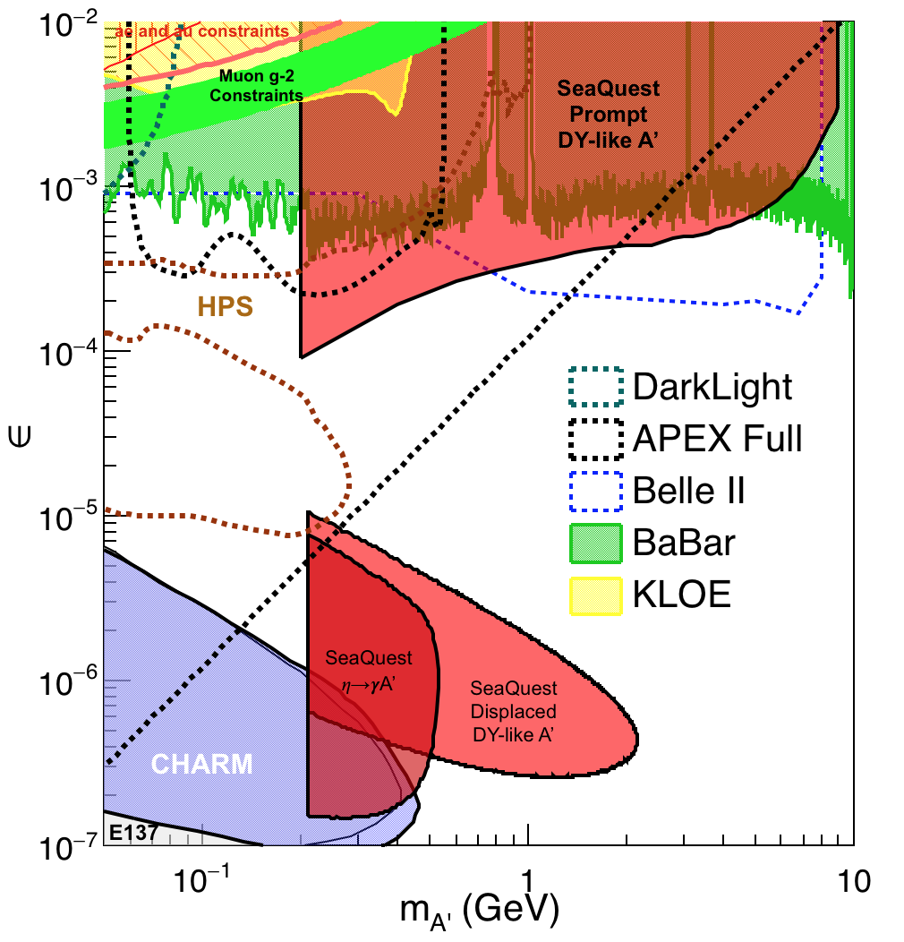
Projected Sensitivity with 2-year Parasitic Run with Polarized Drell-Yan E-1039 Experiment
Parasitic run with polarized Drell-Yan
  2018-2019
Assuming 2-yr (400 days) of parasitic running

Slide 11
If additional fund available in FY17…
Given the uncertainty of future run beyond 2017 at Fermilab, it would be very helpful to have additional $$ and technical resource support to speed up the DAQ/trigger upgrade to take maximal amount of data out of current 2017 E906 run
More manpower could be used to speed up assembly, trigger algorithm development, testing readout and installation, in particular in the following tasks:
  Trigger logic FPGA programing support
  Electronic tech to help SiPM readout, LV/HV, installation and debugging
  Mechanical engineer to complete the safety document for the Fermilab review
Procurements of small items
  Fiber-SiPM adaptors
  Lemo and ribbon cables
  Big frame to hold 4-frames per plane, detector pre-installation safety review
Move PHENIX two EM Calorimter sectors from BNL to Fermilab, installed at SeaQuest after summer 2017.
  Free from PHENIX, a ~$2M detectors, with PMTs and HV PS
  Shipping cost ~$10K

Slide 12
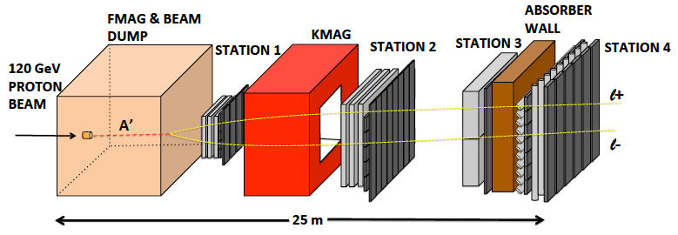

E-1067 Future Upgrade: New Idea
2018 ~ 2025+
Add tracking detectors close to “target” to improve mass resolution
Add EMCal, PID
e^{+/-}, h^{+/-} , π^{+/-}

Slide 13
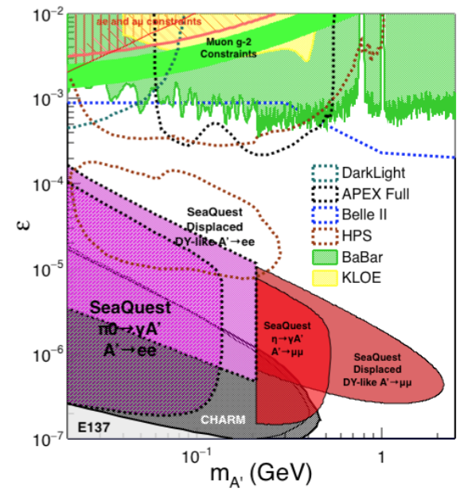
Displaced Low Mass Dark Photons with EMCal upgrades
Projection: POT 1.4 x 10¹⁸
Detector upgrades
  EMCal: e^{+/-}
  HCal: π^{+/-}
  Recycle from other experiments, PHENIX/RHIC etc.
DAQ upgrade
  100+ kHz
Timeline of runs
  2018+
Detector configuration
  Access low mass region with optimized Fmag settting

Slide 14
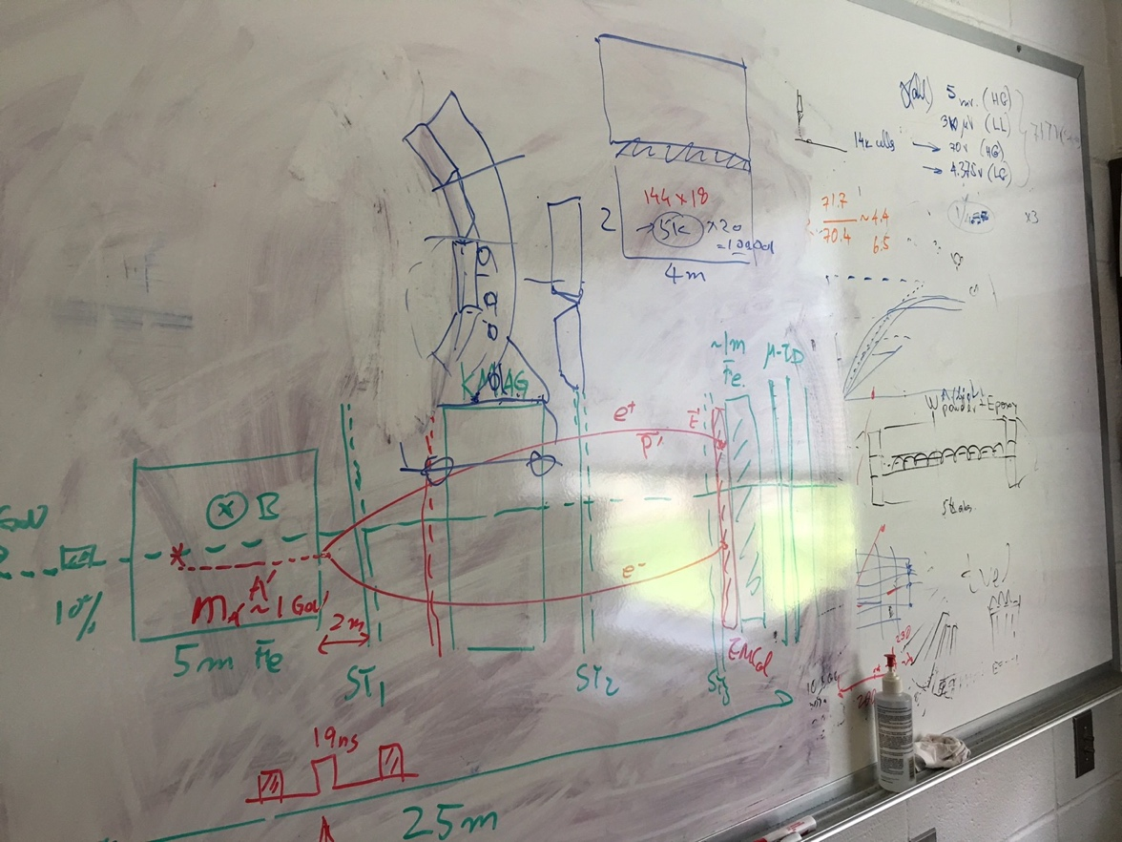
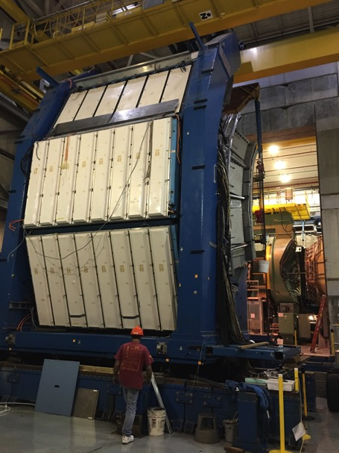
EMCal from PHENIX/RHIC
2 EMCal sectors are available from PHENIX experiment at RHIC, ~end of 2016
  One sector:
    2m x 4m, 18 (3x6)super modules
    Super module = 36 modules; Module = 4 towers
    36 x 4 x 18 = 2592 channels
    Could gang 2x2 (or 3x3) into one ADC/TDC readout
Available in summer 2017 for
installation at Fermilab
- dE/E = 8.1%/sqrt(E) + 2.1%
- dT < 200 ps
- Excellent e/pi separation

Slide 15
Projected Dark Higgs Sensitivity
POT:1.4x10¹⁸ (Phase-I)
Y. Zhang (2015)
Dimuons with downstream displaced decay vertices
Limited sensitivity to “prompt” large mixing case due to small cross-section
Dark Higgs or dark photons?
  Dimuon kinematic and angular distributions
Phase-II
  Dedicated high luminosity runs optimized for low mass acceptance, mass<3GeV
1x
5x
25x

