Slide 1
PHENIX EmCal PbSc in SeaQuest, FNAL
A. Durum for IHEP group, June 08,2018

Slide 4
EmCal PbSc others structure
Inside sectors
Alarm system – door ajar, heat, water, smoke detectors
HV current monitoring system
LV, HV, Signals cables, Arcnet cables to load FPGA
PMTs
PMT’s bases – one base for four PMT FEU115M
FEMs with trigger cards and triggers cables
Cooling system – fans
Onboard pin diodes for online monitoring system
Outside sectors
LV and HV power supply
REF FEM for online monitoring system

Slide 5
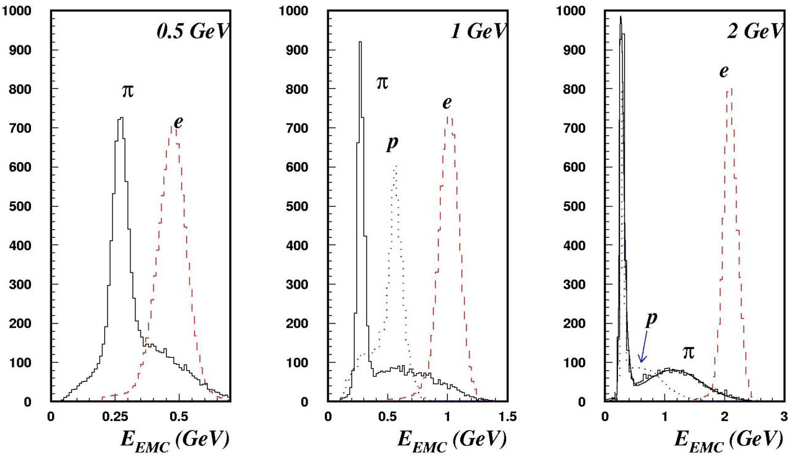
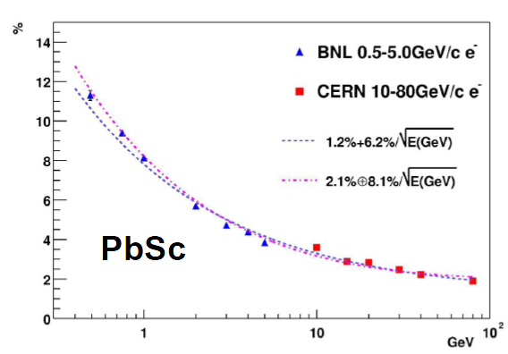
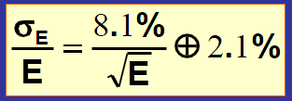
PID

Slide 6
EmCal PbSc Performance Uncalibrated Tower Summary from Run16
Sector | Total | Not a Hot/ Dead Tower | Hot/Dead Towers | Next to a Hot/Dead Tower
W0 | 1 | 1 | 0 | 0
W1 | 2 | 2 | 0 | 0
W2 | 8 | 7 | 1 | 0
W3 | 14 | 1 | 10 | 3
E2 | 8 | 8 | 0 | 0
E3 | 4 | 2 | 2 | 0

Slide 7
EmCal PbSc Performance Laser Monitoring Data from Run16

Slide 8
EmCal PbSc Uncalibrated Tower Summary

Slide 9
Questions
Which sectors delivered to FNAL?
Current or new electronics?
PMTs or new readout sensors?
Monitoring system – current or new?
How IHEP group can help to run EmCal PbSc:
We look forward to future cooperation, but…
Due to restriction access on DOE Lab - remotely work?
RMES funds are frozen for US in current situation.
???

