Slide 1
Hardware
Hubert van Hecke
Sanghoon Lim
Alex Wickes
Shaun Newman

Slide 2
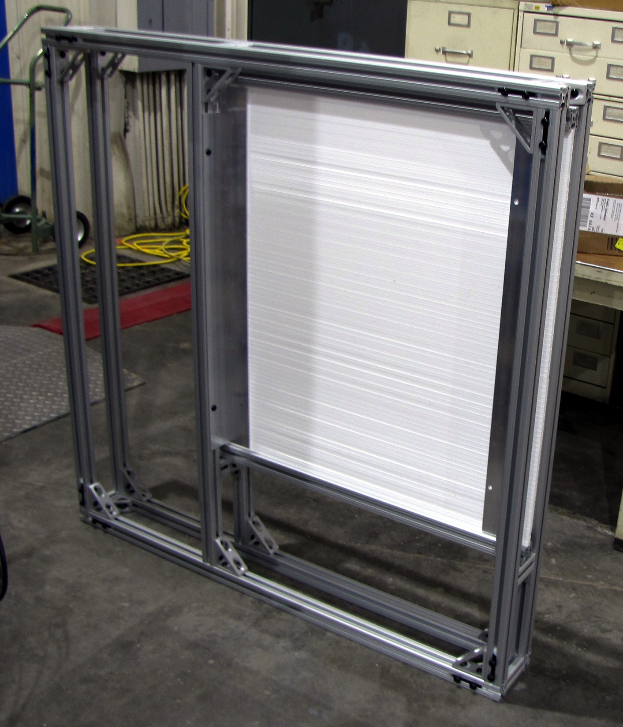
Frames
4 frames for 1x1x80 cm bars
4 frames for 2x2x100 cm bars
Mostly finished
To be done:
Feedthroughs and/or patch panels for cables
Cooling air feedthroughs

Slide 3
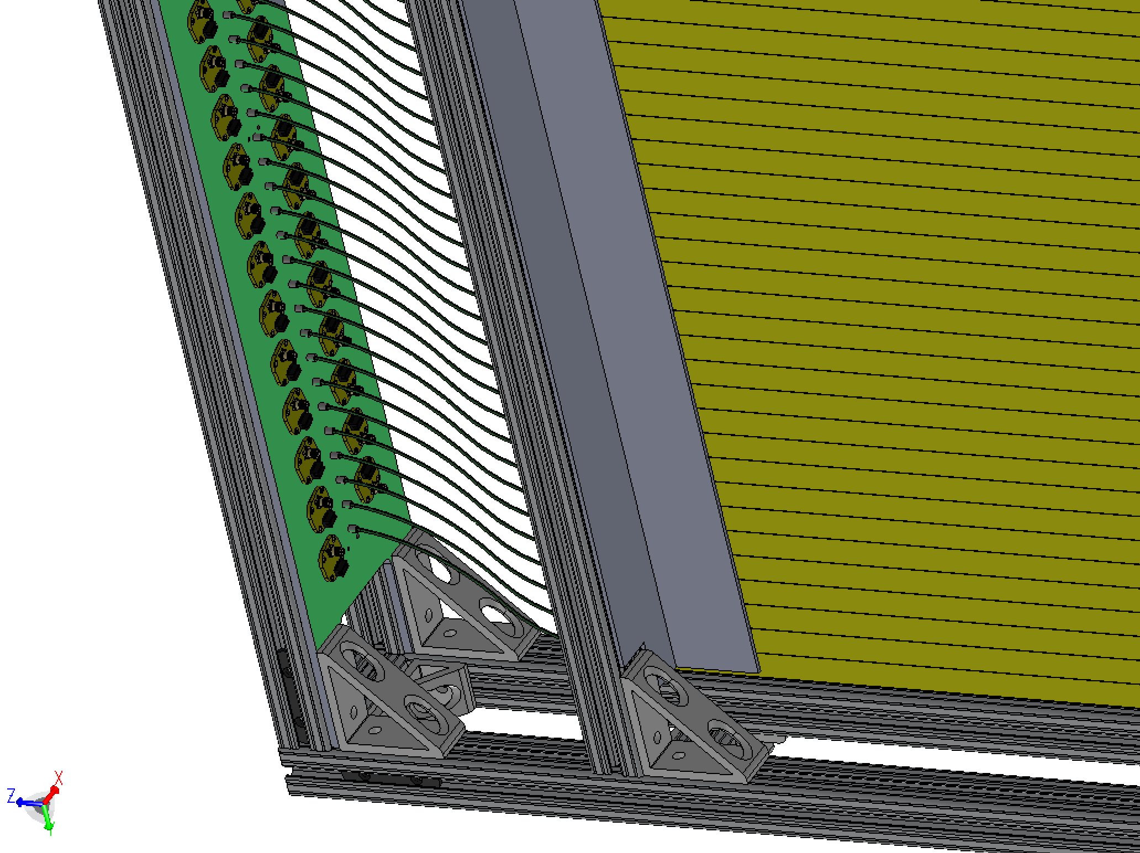
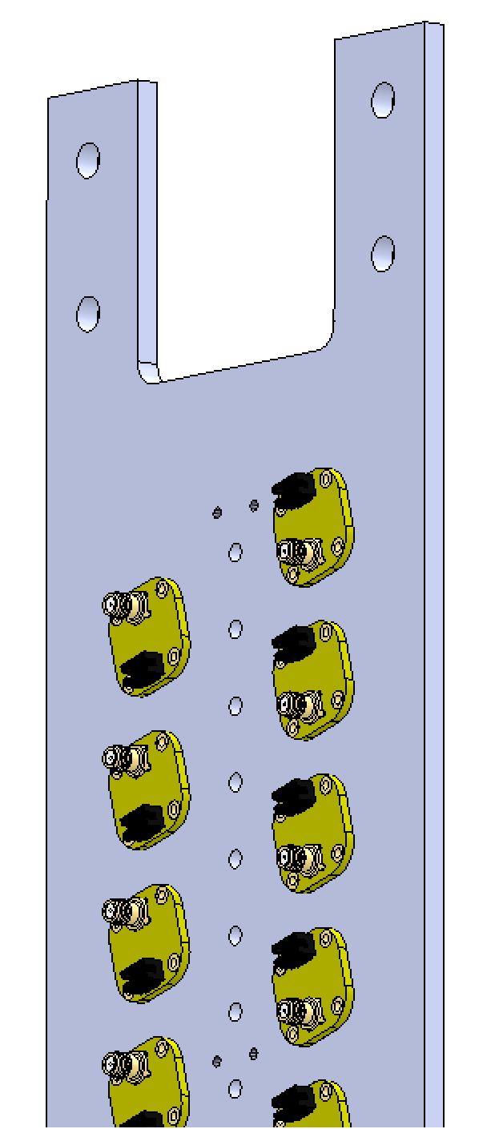
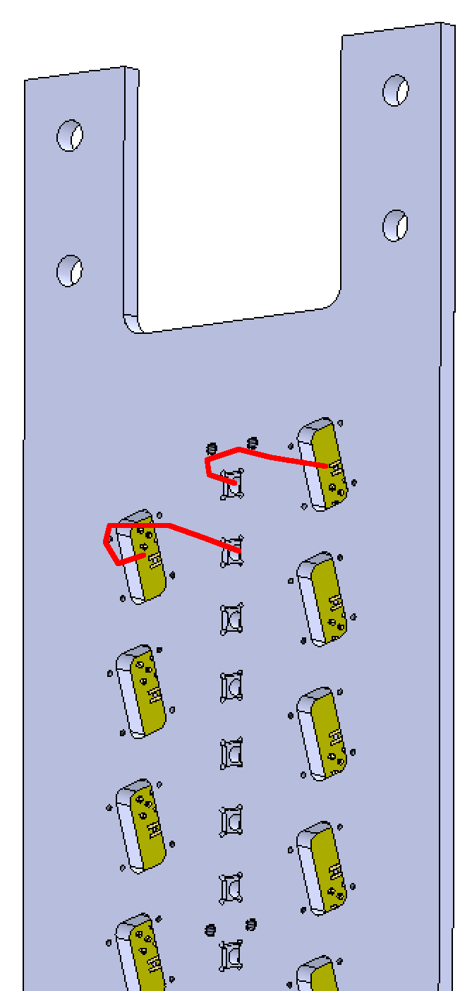
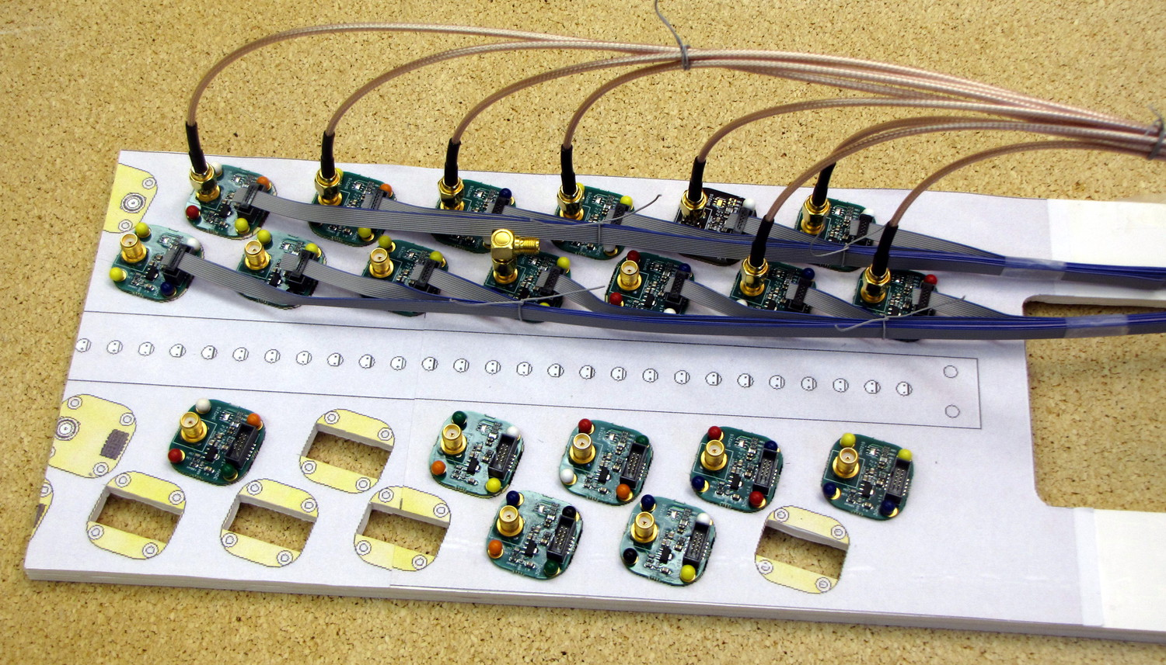
Readout plates
Fibers and preamps in the front
SiPMs connect with pigtails in the back
Fabrication bids are out
front
back
Full-scale mockup for cable routing and connector finger space

Slide 4
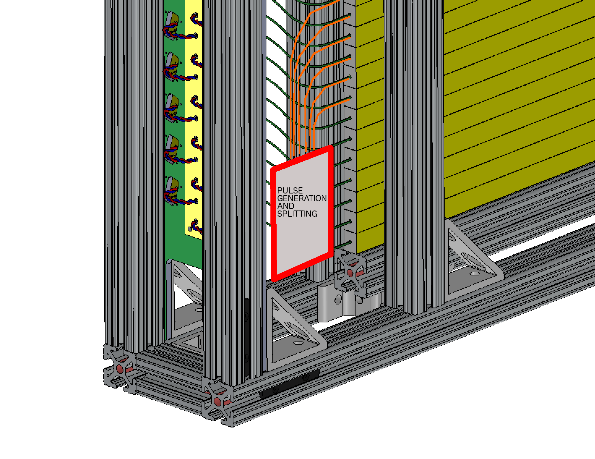
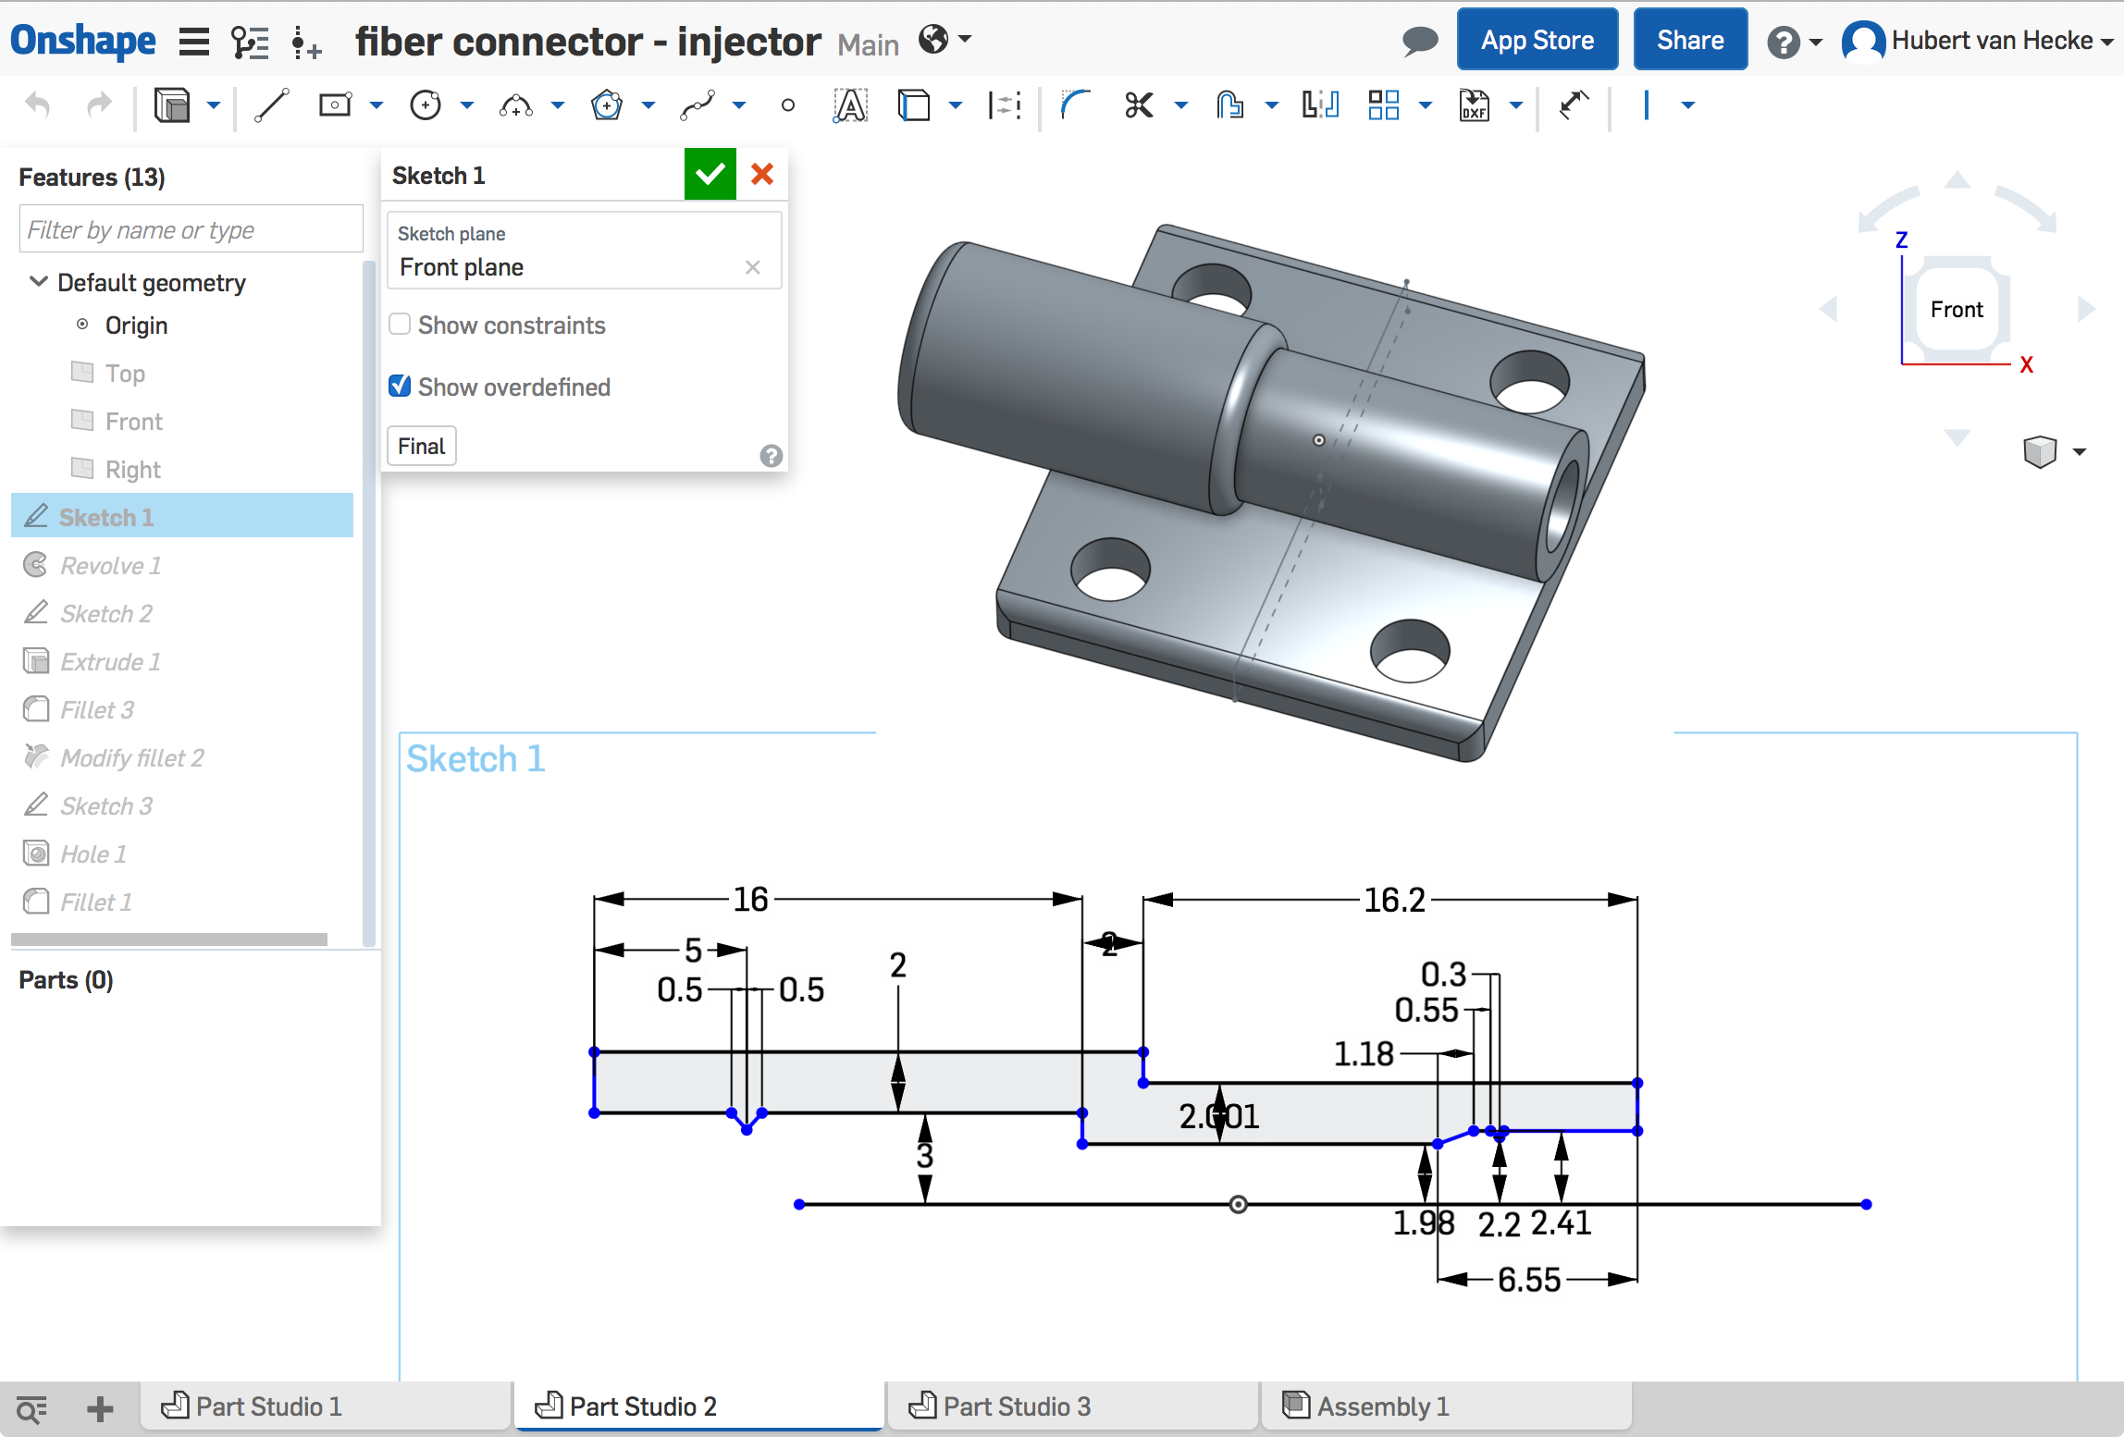
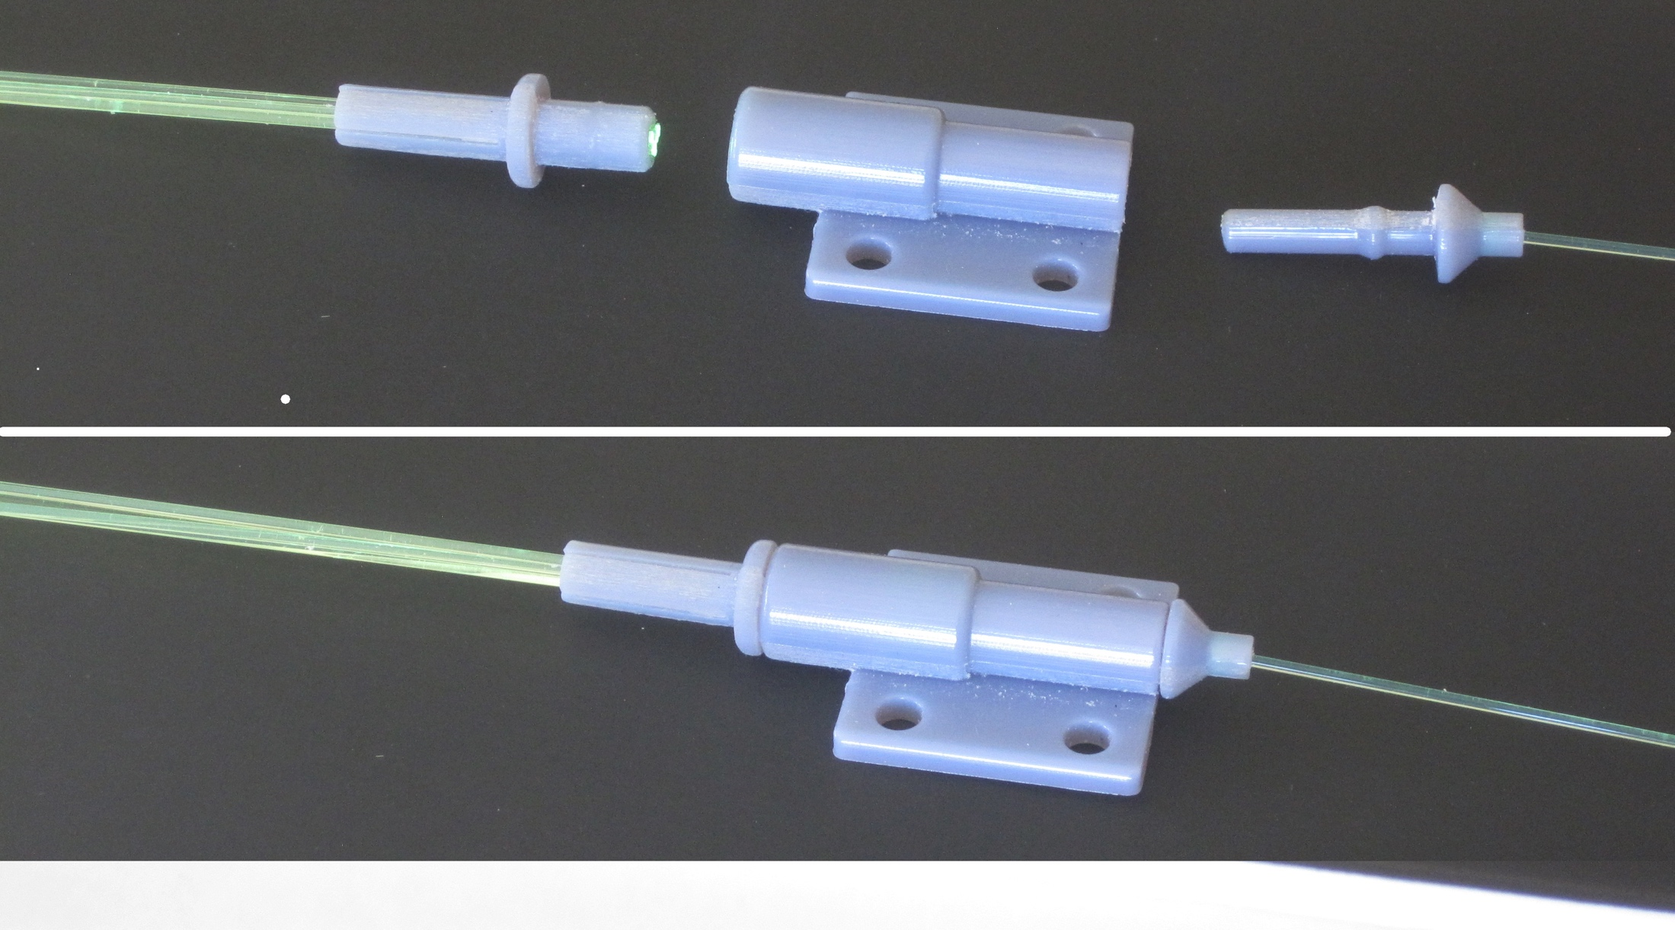
Calibration system
Use existing pulser board design from Pat
1mm plastic fiber output
Fan out to 7 (19) clear 1mm fibers
Insert these into each scintillator bar
To be done:
Lay out pulser board with n pulsers, and build
Cut and polish pulser fibers
Design mounting
3D print
1->7 fanout

Slide 5
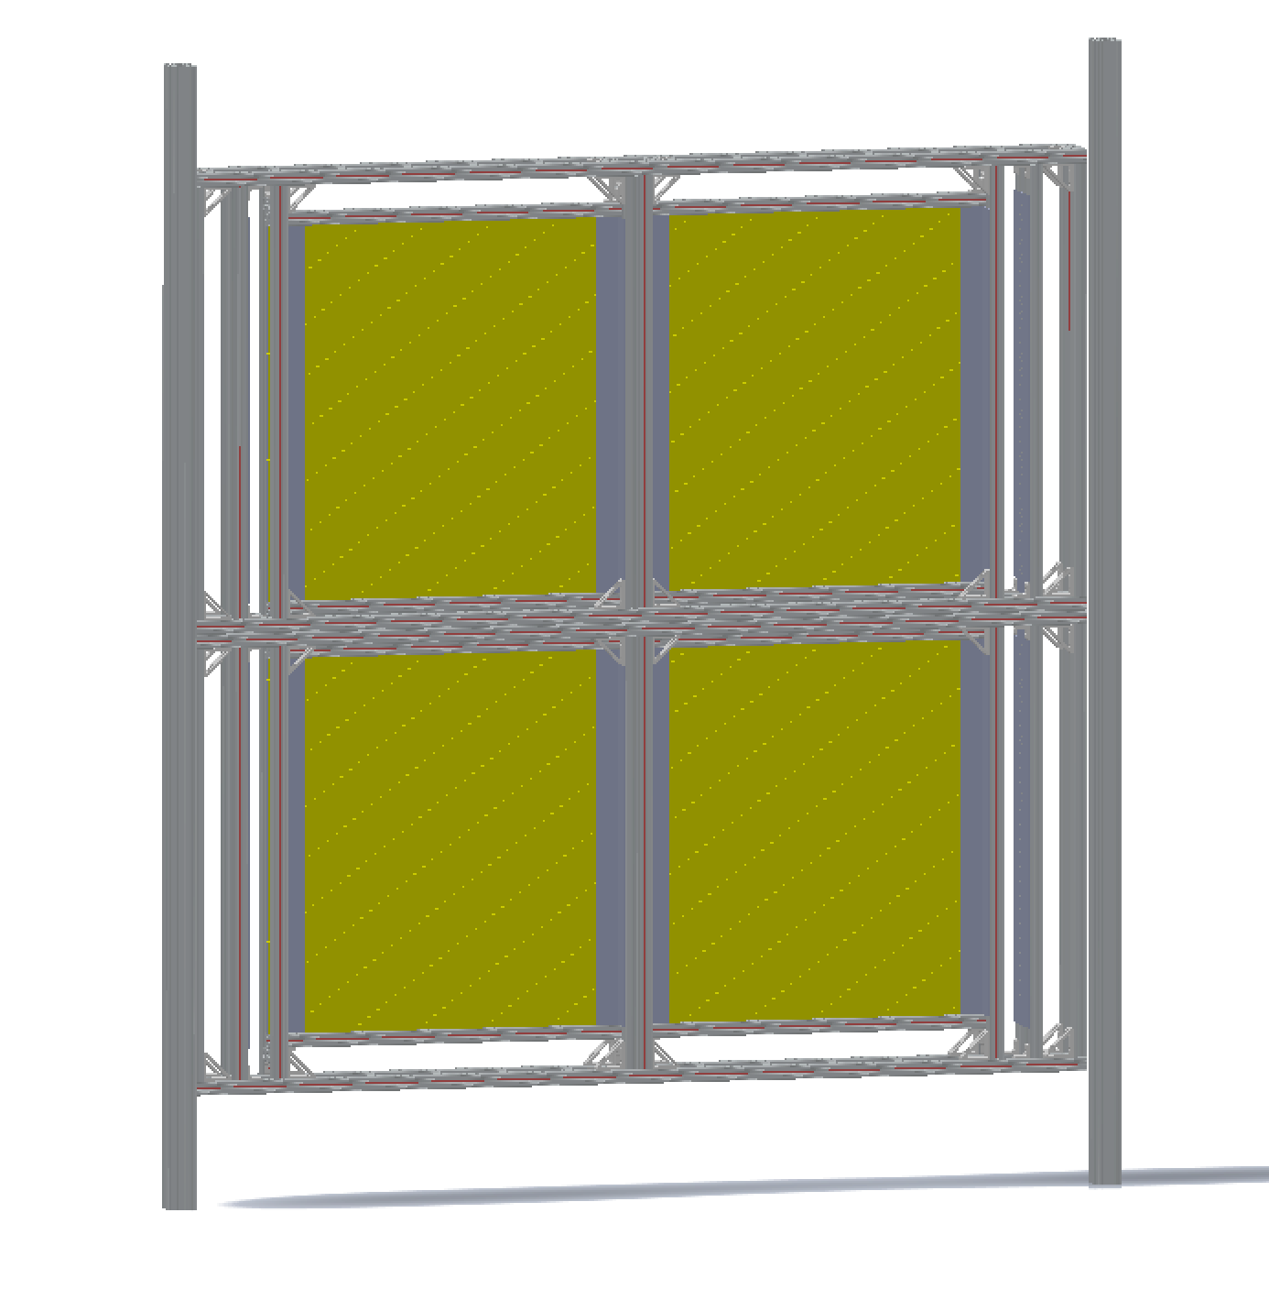
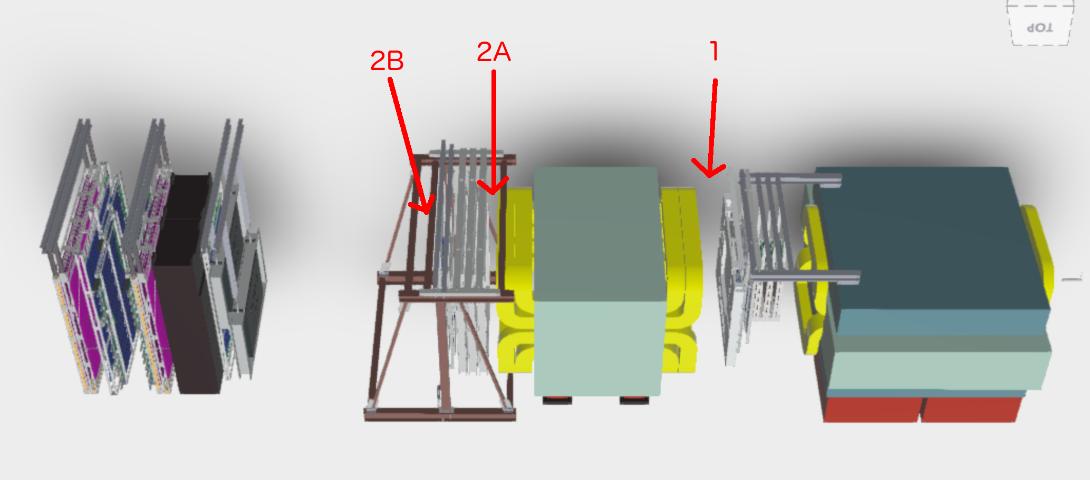
Installation
4 boxes joined
2 vertical beams hold this assembly
Anchored to floor and overhead beams
To be done:
Details of mounting points
Safety review
Determine external cable routing
Cooling fans

