Slide 1
Proposal to DOE/OS
Cesar Luiz da Silva
Los Alamos National Lab

Slide 2
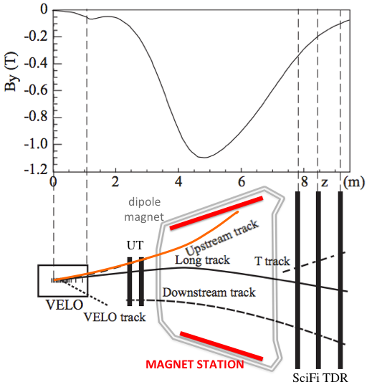
MOTIVATION
δp/p~15%-20% for upstream tracks
A 1mm z resolution tracker inside the magnet provides momentum resolution similar to long tracks

Slide 3
Proposal is for the gluon saturation search, a hot topic for US Nuclear Physics
Referee comments from last years submission were very positive on the physics, but they were skeptical about the efforts for MS

Slide 4
Review’s Comments
Overall, I am strongly enthusiastic about the idea of using LHCb to probe low-x gluon distributions. This is counterbalanced by strong skepticism over whether the proposed level of effort is adequate to build the proposed detector. If this is not funded this year, I would strongly encourage the PI to re-propose this, with either a more developed MS design and resource estimates and/or additional collaborators, or a more modest contribution to LHCb.
The proposed subdetector will be built inside an existing magnet, in a high radiation area, and will have to be read out at high speeds into an existing data acquisition system. There will also be considerable need for manpower for online and offline software and calibrations; these topics are not addressed. It may be that there is additional manpower available at CERN or at collaborating institutions, but this is not addressed in the proposal.
It is not 100% clear from the proposal, what part of the MS will be done by LANL personal and what part by other LHCb groups. If LANL has to do all, the listed manpower is too small. One postdoc and 2-month of an engineer per year is not enough, technicians, both mechanical and electrical will be needed. If the proponent only contributes to the project and the MS is dominantly managed, and supported through other existing LHCb groups, then the upgrade is clearly feasible. The proponent should have been more explicit in his proposal on this point.

Slide 5
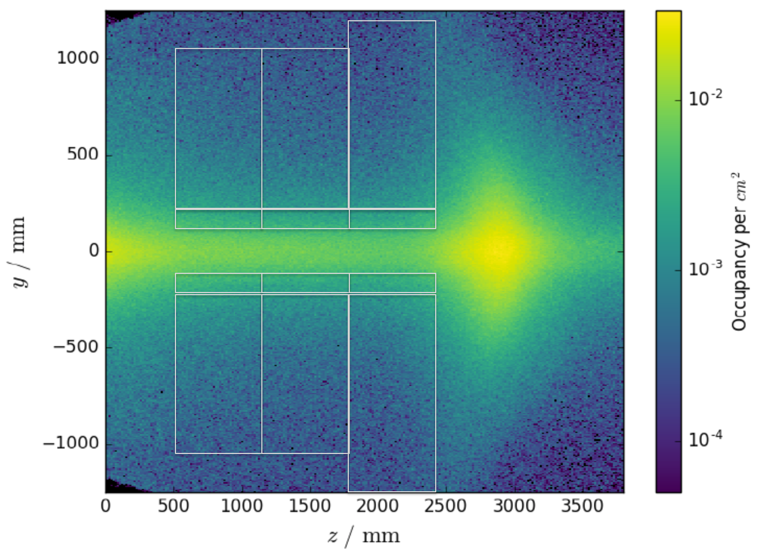
Segmentation
90cm
64 cm
10cm
24 panels
< 5 % occupancy determines the location and size of the panels
pPb may have a factor of 5 larger ? ( mu<1)
Run IV occupancies are 10x larger
Need a simulation to have some idea about integrated occupancies in the triangular bars
Each panel: 128 bars x 6 planes = 1536 bars/channels

Slide 6
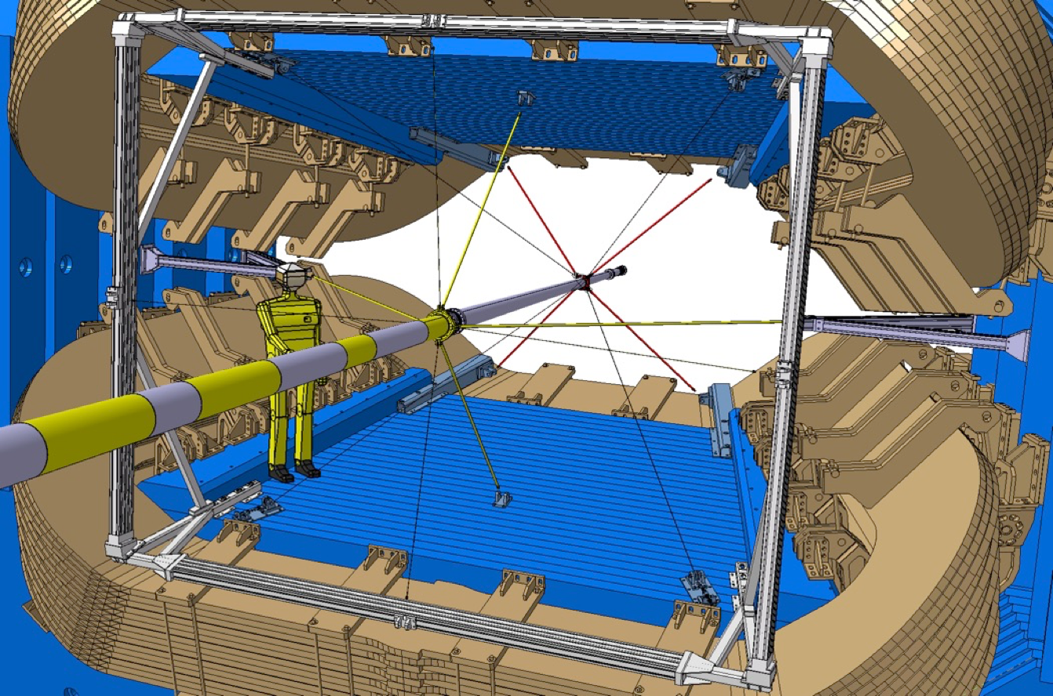
Mechanical Structure
Rail installation during LS II
How the clear fibers will run out of the magnet ?
Crates on the sides of the magnet for SiPM, readout electronics, power supply and cooling. May need the solid works drawing of the platform.
Tracking panels will be installed after LS II

Slide 7
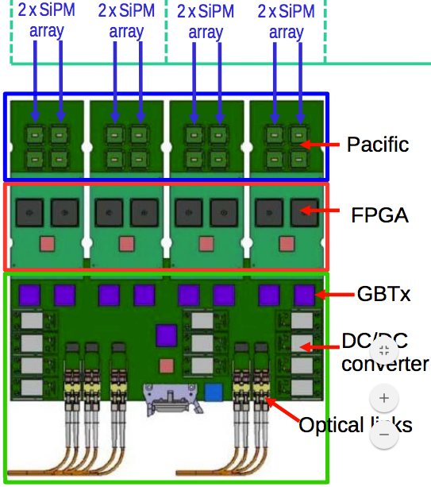
Adopting SciFi electronics
NO clusterization in the cavern
Though about online tracking in the FPGA, but than can be done in TELL
40 MHz x 5% occupancy = 2MHz
18 bits per signal (ID+2ADC bits)
36 Mbits/s/channel
2.3 Gbits/s/PACIFIC chip
GBTX can transmit 4.8 Gbits/s
May need one GBTx per ALPIDE for safety
X
X
X
X

Slide 8
May need 576 optical fibers for data transmission

Slide 9
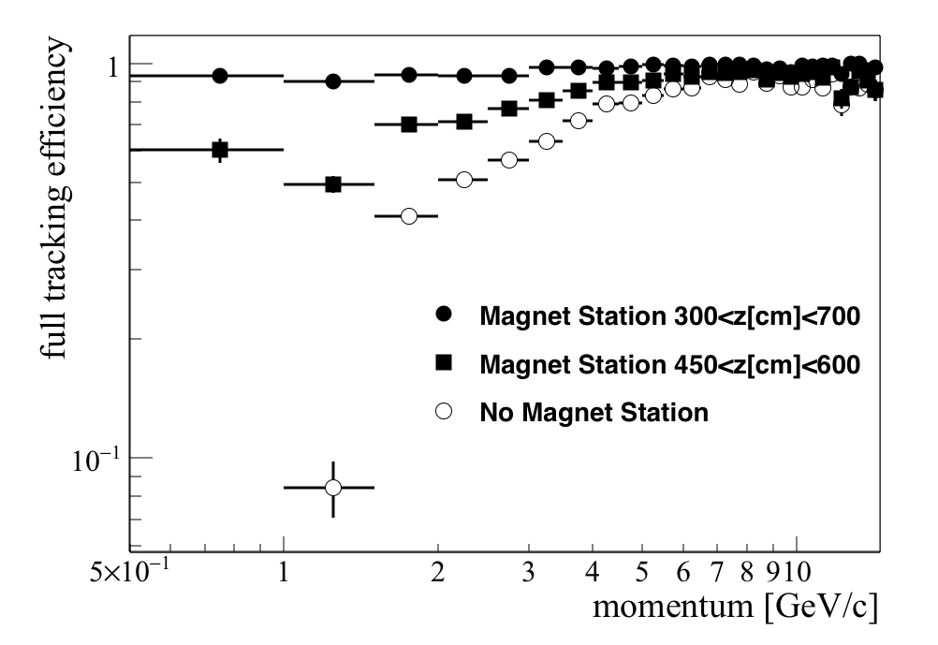
Track efficiency gain with MS
Track efficiency still from last year. I need to run the Gauss simulation
May also need Drell-Yan MC to test gain in acceptance for di-electrons, a key probe in the proposal

Slide 10
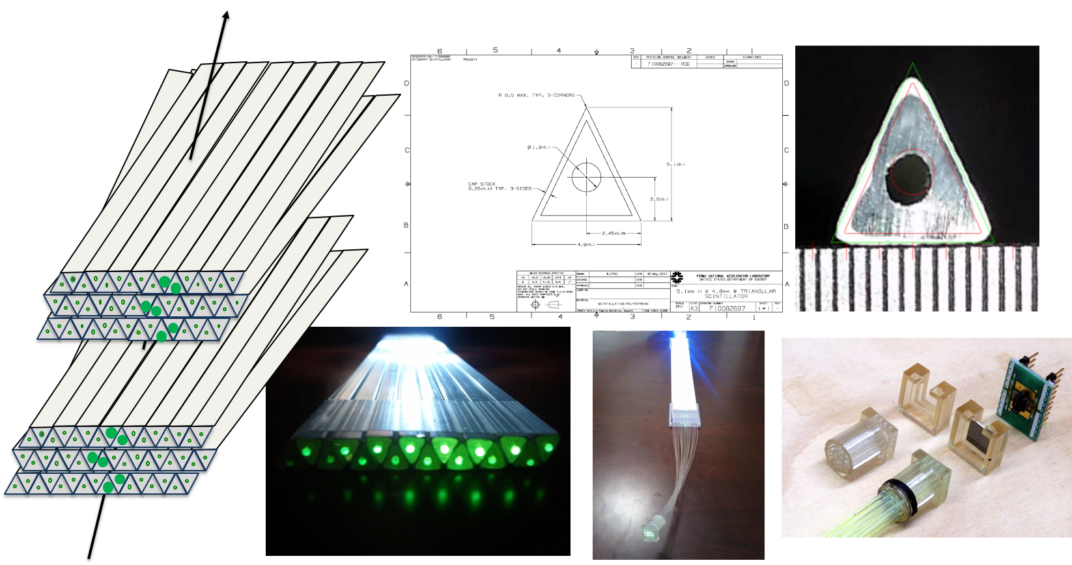
The starting of a Collaboration ?
Despite the 15 pages limit to explain physics and detector, could briefly mention hardware/software efforts in many places
LANL, FNAL, CERN, Heidelberg, CNRS, UZH, EPFL, PAN, Aachen
I may need a statement of support from Institutions to the proposal’s appendix

Slide 11
COST
Fibers / bars+WS | ~120 KCHF
Clear fibers | ~180 KCHF
SiPM | ~300 KCHF
Electronics(PACIFIC, GBTx, TELL40, etc…) 10CHF/channel | ~400 KCHF
Infrastructure, cooling | 200 KCHF
TOTAL | ~ 1.2 MCHF
Need to ping FNAL, Hamamatsu, Kuraray to deliver quotas I asked months ago.
What is the actual cost of PACIFIC, GBTx and fibers ?

Slide 12
SCHEDULE and Effort
R&D and technical details development until a decision on the detector option in 2020
Man power and tight schedule during LS II are serious issues
Decided to propose:
bars and rails in the magnet, as designed by Hubert, during LSII
4/24 panels and corresponding electronics installed in 2022. Panels can be assembly with help of our many summer grad student programs
Proposal driven towards more manpower to the project and HLT development to deliver the physics
If approved, project can start attracting institutions, new funding and manpower
Panel made of scintillating fibers is possible, as long there are more funding for it in the future
Comments ????

