Slide 1
Panel assembly and plans
Hubert van Hecke
Los Alamos

Slide 2
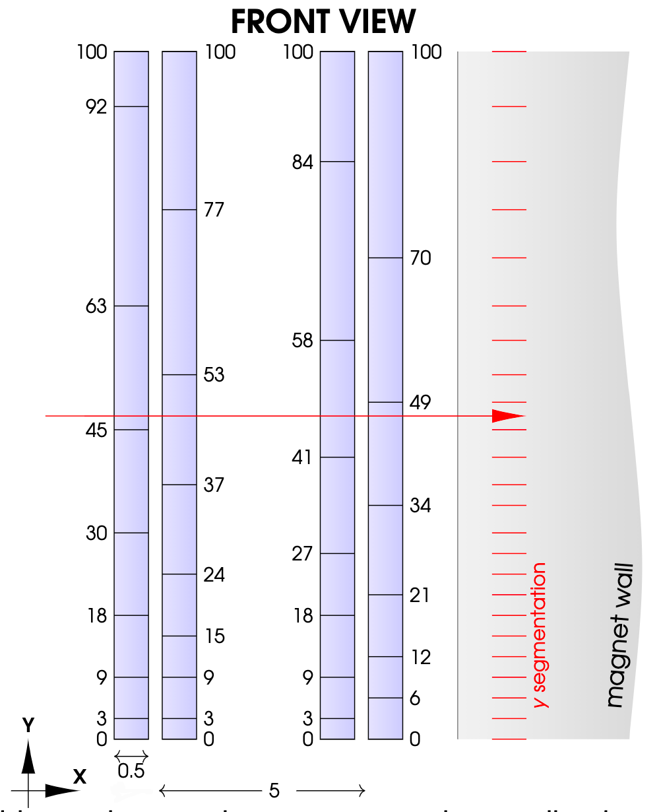
50 cm prototype layout
4 layers, 2 pairs separated by 5 cm
Element size decreases toward center plane
5 cm
x
50 cm

Slide 3
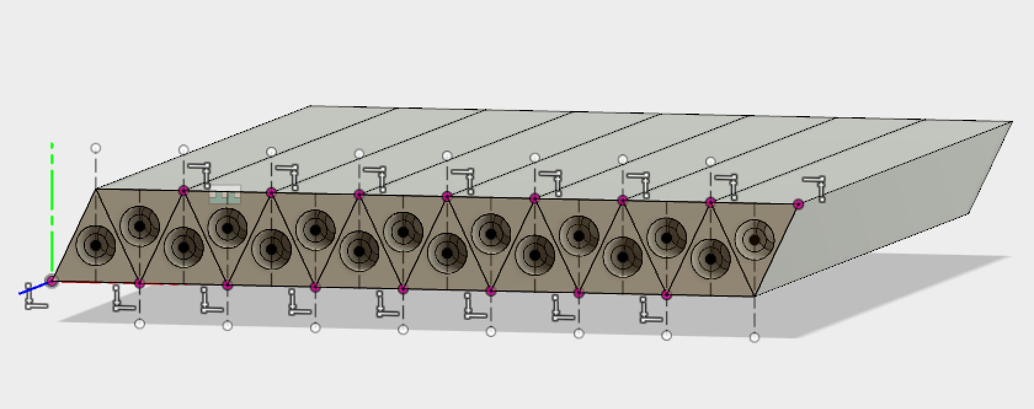
16-bar units
5mm

Slide 4
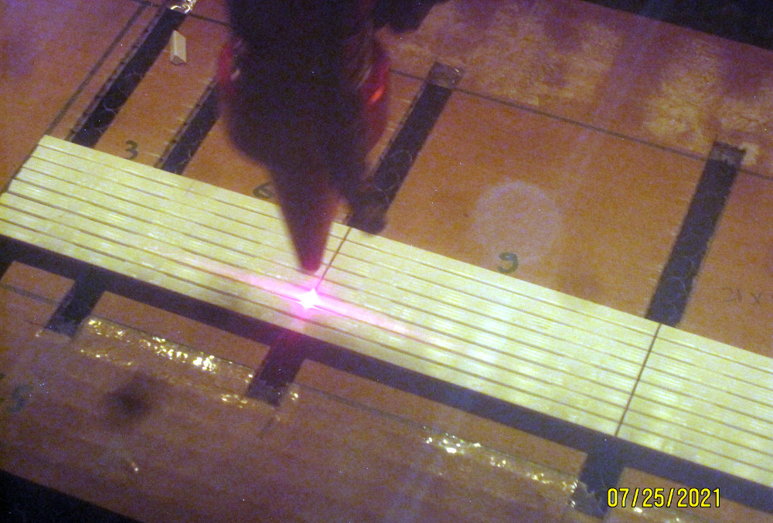
.
Assemble 16 50-cm bars, hold with blue clamps
Apply stripes of glue
Remove blue clamps
Laser-cut into blocks
Enough to construct
4 50 x 50 cm layers

Slide 5
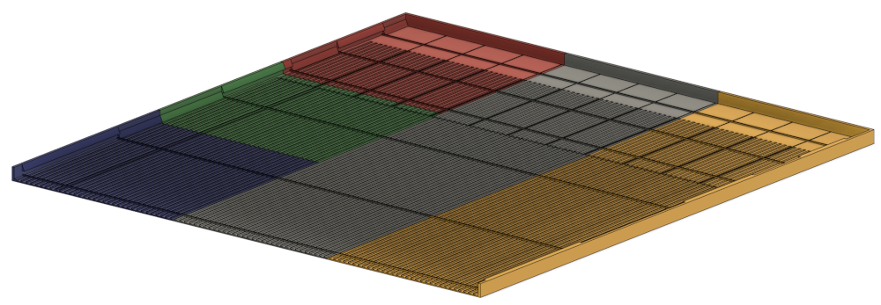
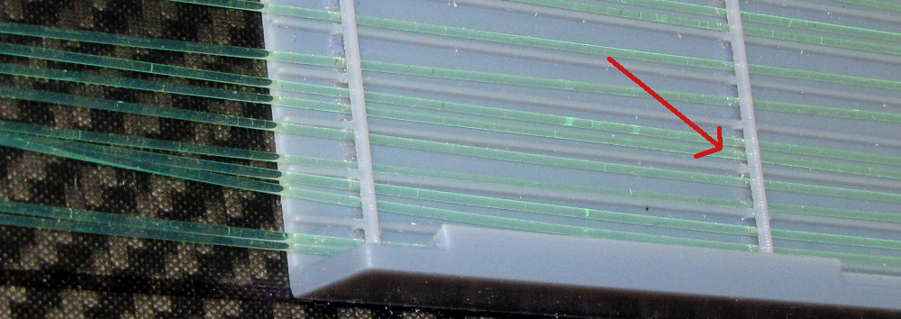
Assembly tray
~50 x 50 cm tray printed in 9 sections
4mm grooves every 5mm to hold
4 1-mm fibers
Fibers pass under bridges

Slide 6
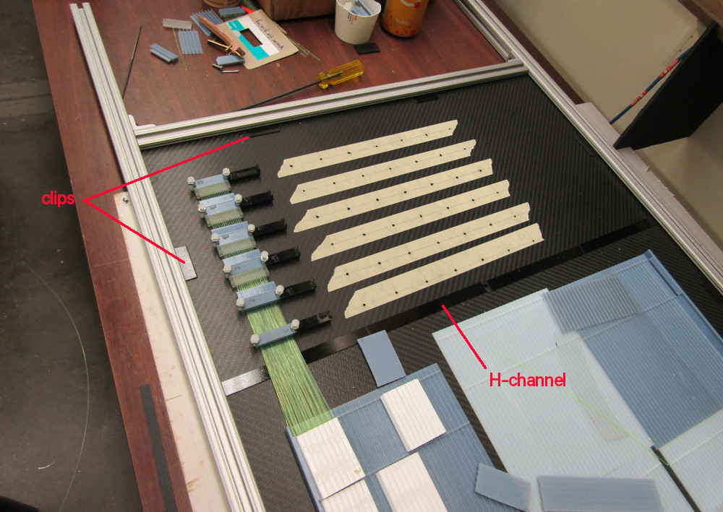
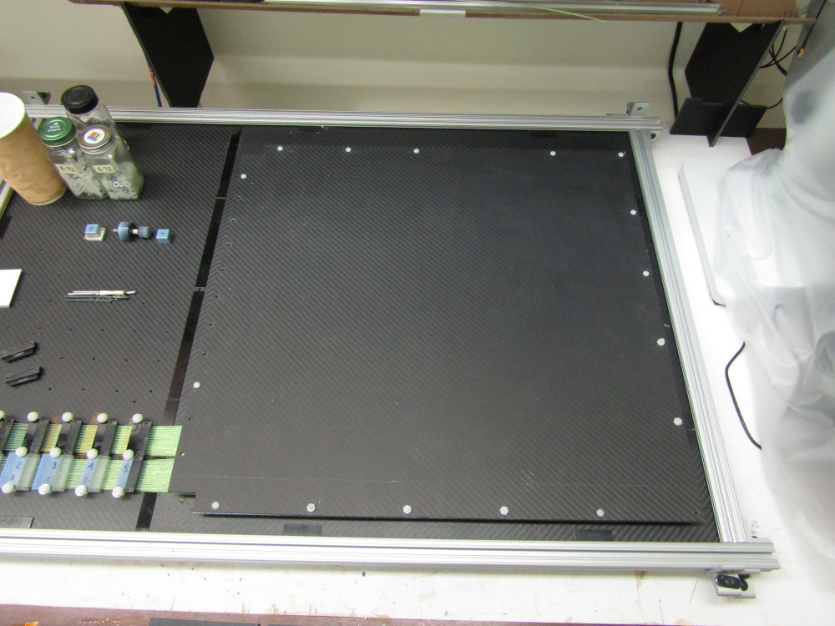
Assembly frame
Carbon honeycomb
Cover sheet
Tray glued to carbon
3mm carbon-fiber-honeycomb sheet
80-20 Aluminum frame

Slide 7
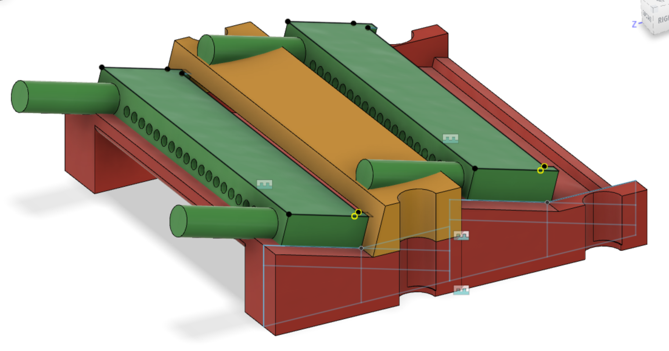
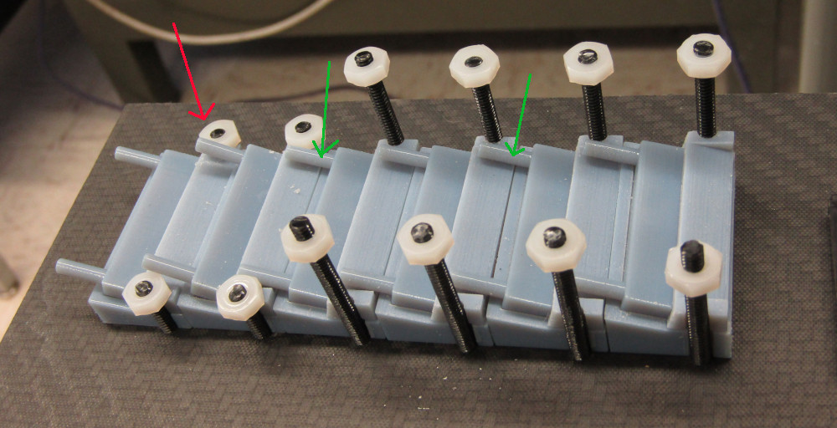
Fiber couplers
At Fermilab, we saw these couplers:
Outgoing fiber side
Mock them up, and design holders
Clear
out
WLS
in
18 1mm fibers
35 mm wide (<50)
Polished face
Here, all WLS fibers come in on the bottom

Slide 8
Modify last 3 holders
Fibers from connectors A, B, C go low
Fibers from D, E, F go high
A
B
C
D
E
F

Slide 9
Test assembly

Slide 10
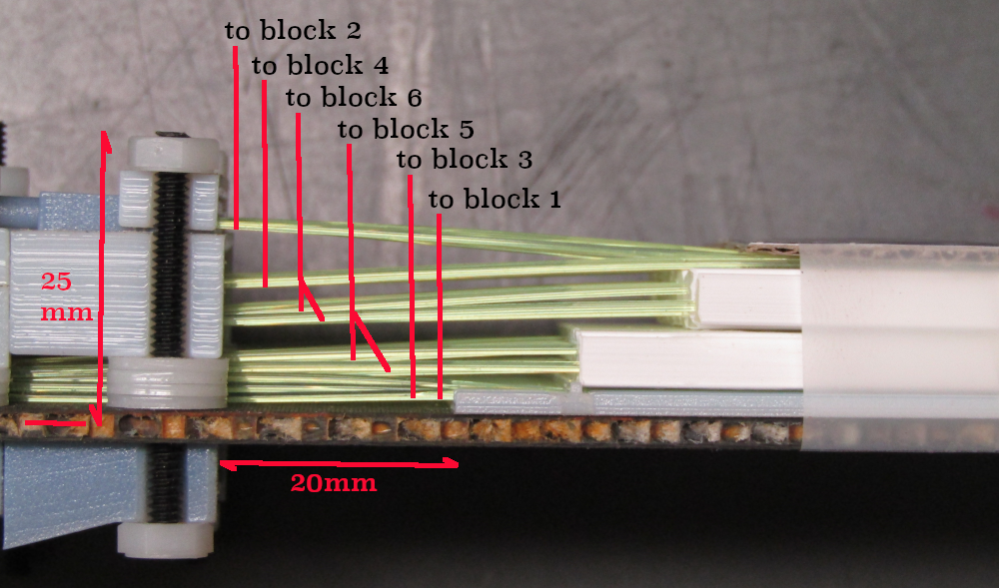
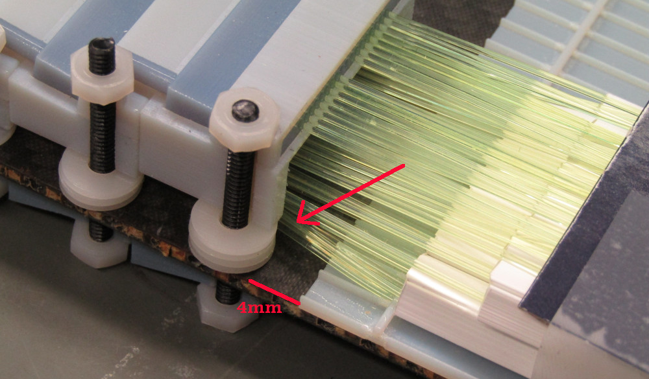
Moving connectors closer
.
With new holders, vertical bends are gentle,
And we can move them closer to the tray
But then there is a bad horizontal bend
Modify the last connector holder to give
These fibers more room
Now connectors can be pushed all the way
Against the tray – minimal space used (12 cm)

Slide 11
4 layer close fit
5 cm

Slide 12
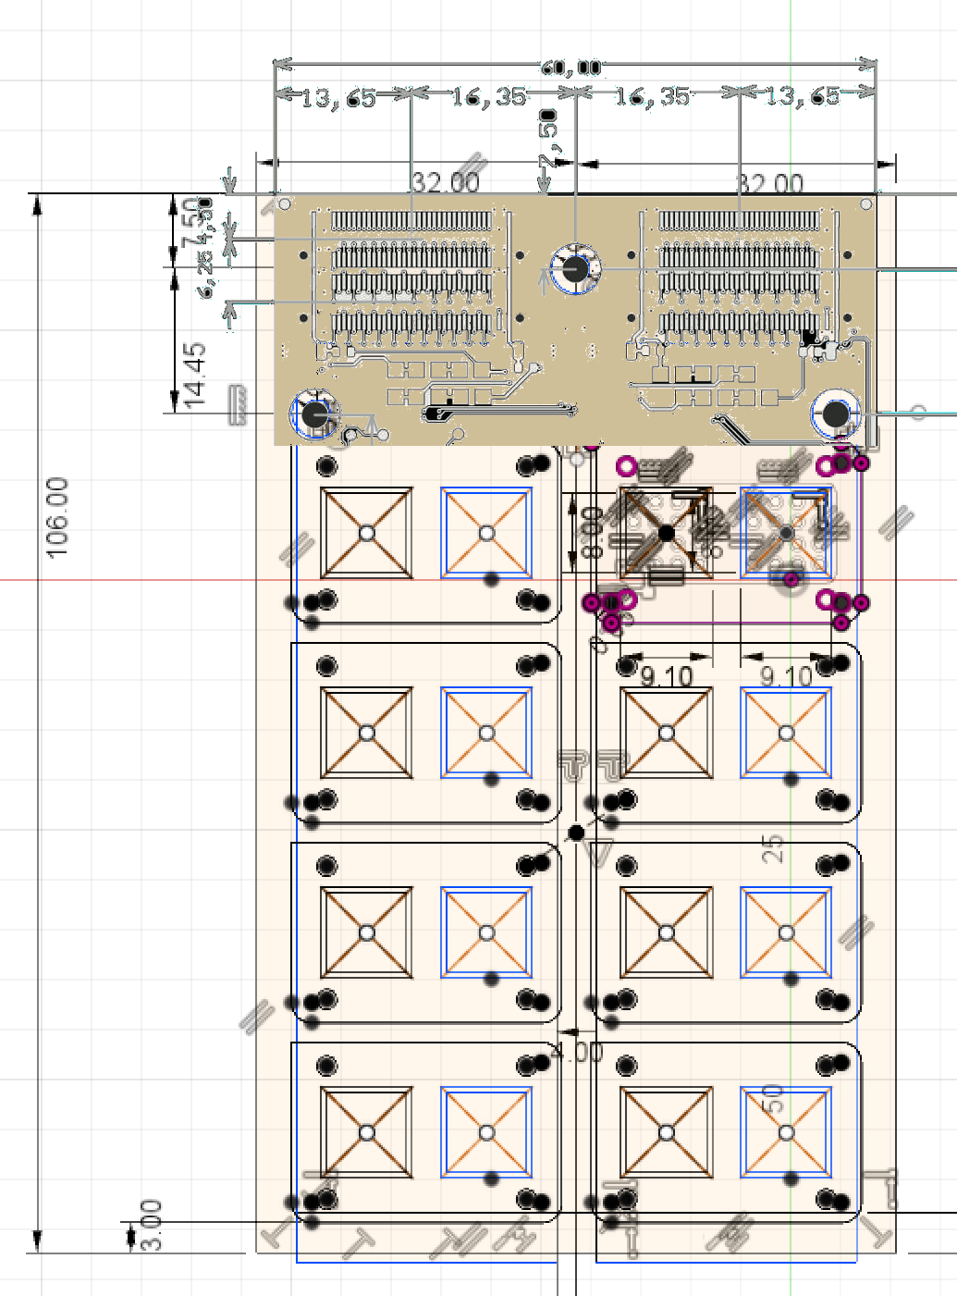
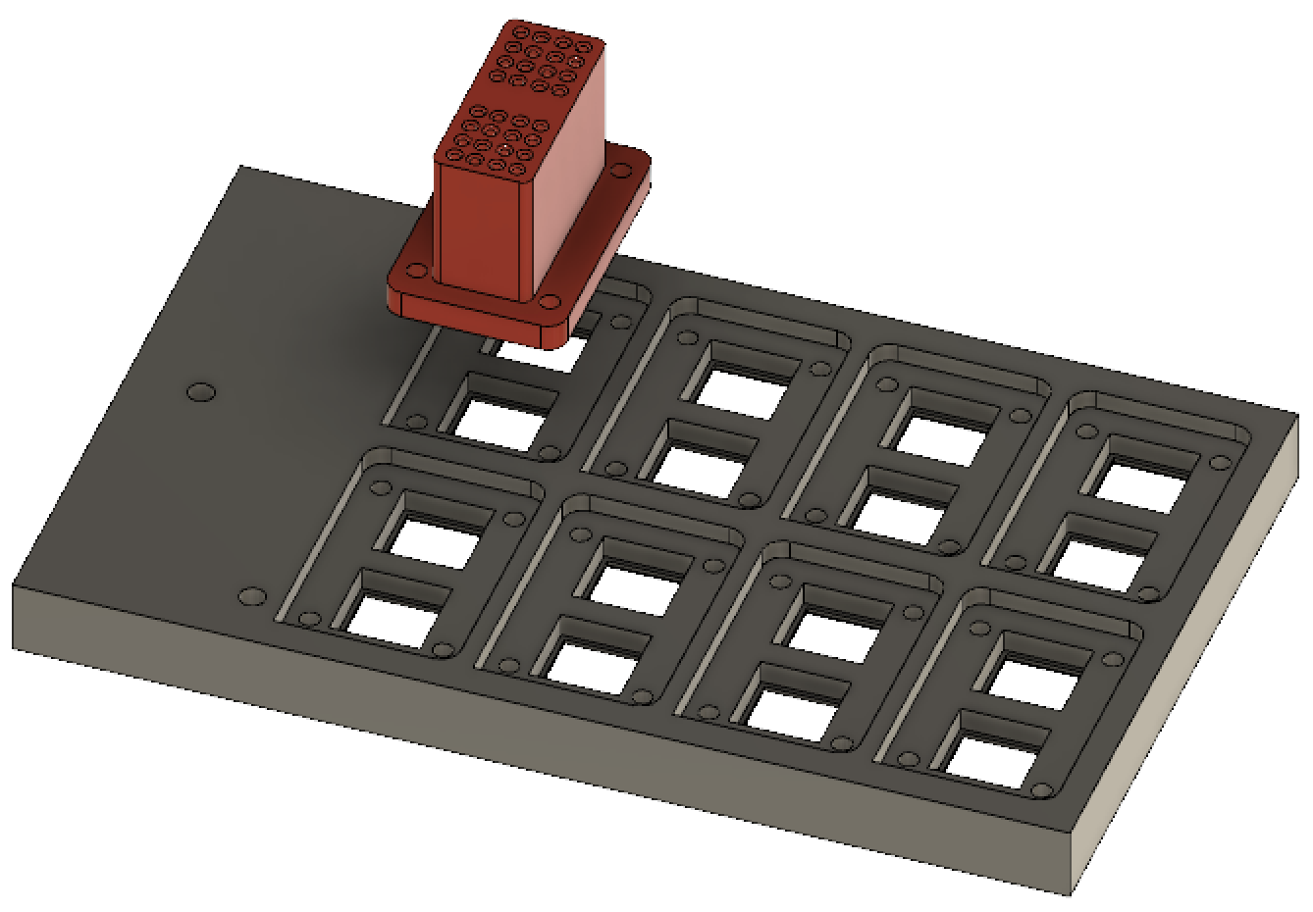
On the readout end
2 x 16 clear fibers
4 x 4 mm
SIPMs
Design by Arielle Platero
Connector holder block
matches PC board

Slide 13
How to install?
Y-shaped brackets (red) hold
pairs of rails (green)
Fiber routing, cable trays

Slide 14
Next
Is there enough light to read out with 1/2mm fibers?
Yield down by 4, probably enough
1/2mm fibers are much more flexible – ease of installation
Obtain connectors
Depends on (1)
3D print or injection-mold components
Quantities are small (48 for some, 144 for others) for this prototype
Printing can keep up with assembly
Go from to
Needed for the 1-meter version
Simplify construction

Slide 15
backup

Slide 16
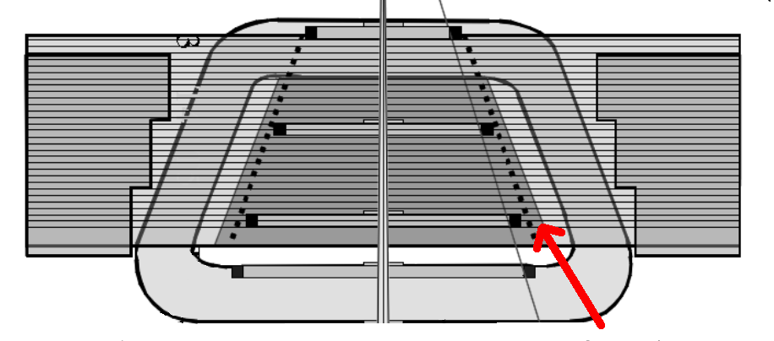
Mount point

Slide 17
Ease of construction
8 fibers, >5mm
4 fibers <5mm

Slide 18
end

