Slide 1
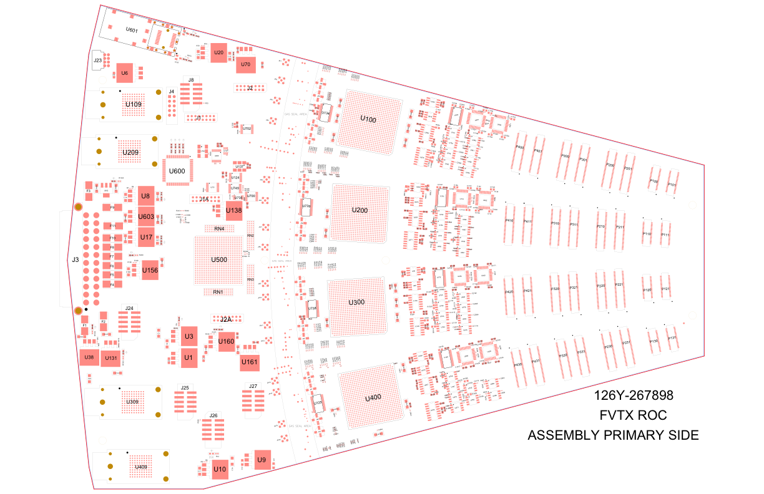
3 New Traces to Add in Blue,
tying GND_ALG-1 and -2 together at 4 pulser outputs
GND_
ALG-2
GND_
ALG-2
GND_
ALG-2
GND_
ALG-1
GND_
ALG-1
GND_
ALG-1

