Slide 1
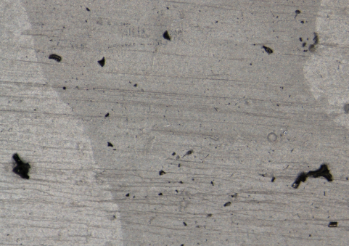
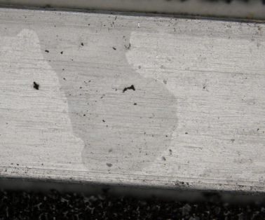
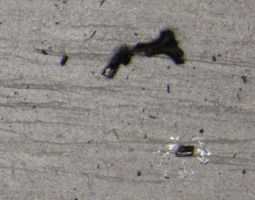
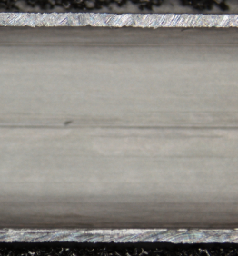
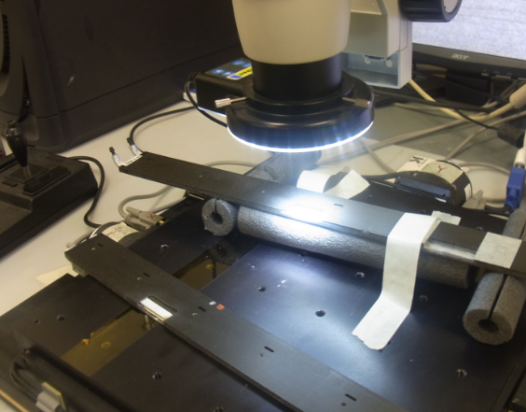
18111039
Top surface of B3L12
1811521
Top surface of B3L12
1812511 B3L12
Tried to blow off, but couldn’t
B3L15
1812709
Insde of tube. B3L15
The dot at the middle is a dust
See 18112820 and 18112908
B3L12

Slide 2
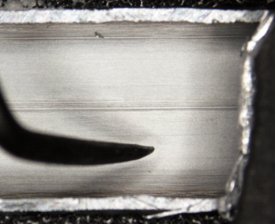
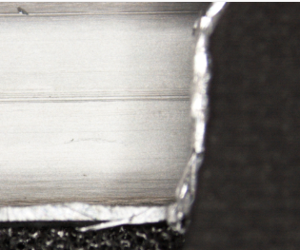
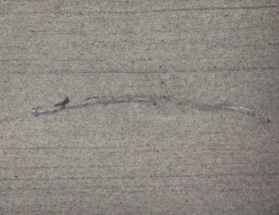
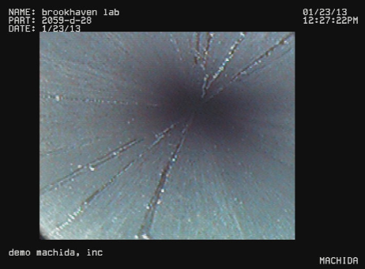
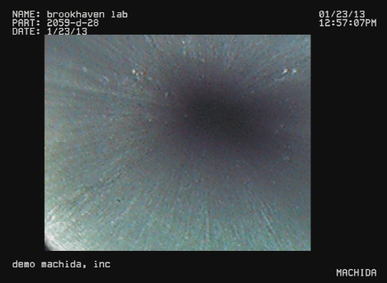
1813442
1813448
1813619
It is very easy to make a scratch mark on the surface. To see this Rachid touched the surface by his tool. Then a clear mark was left. We believe that the same thing happened when we see inside of the tube via the video scope at Machida. The many scratches were made by the scope itself when it touched the surface.
The scratches inside
This is a different place.
But this is the first time the scope comes here. Most likely there weren’t scratches before the scope comes in.

Slide 3
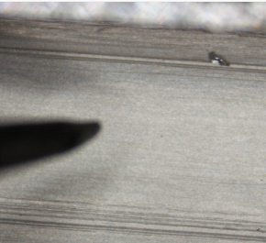
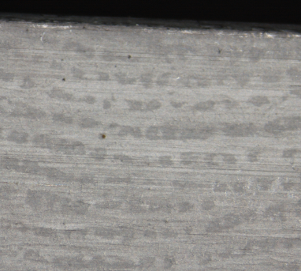
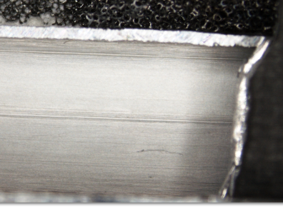
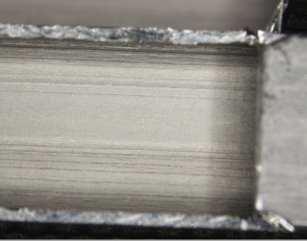
18141346. This is a dust. It was
blow-off (1814506)
18141637. This is out-side surface
of Al tube sample. It is a finger print.
No meaning.
18141726. Inside of the Al tube of B3L15
18142013. Inside of an Al tube kept outside
Never exposed to NOVEC

Slide 4
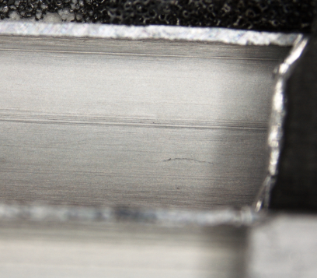
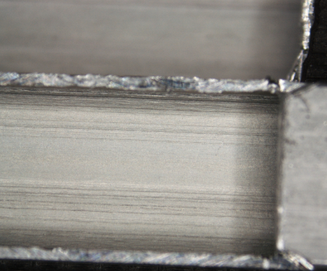
18141943 (tube in B3L15)
18142013 (Al tube kept outside)
The purpose of the 2nd round (noon, with Rachid) is to compare the inside of the Al tube in stave and a sample Al tube kept outside.
These pictures and the following pictures are the comparison of the two. The two samples are placed next to each other. Since the height is different, we need to adjust the focus to see the surface of each sample.
It seems that their surface are similar. Hard to distinguish. Both has some sort of soft coating developed. Oxidation?

Slide 5
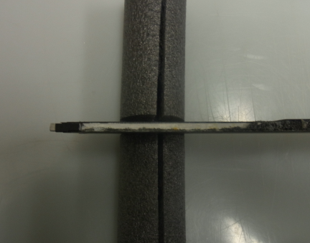
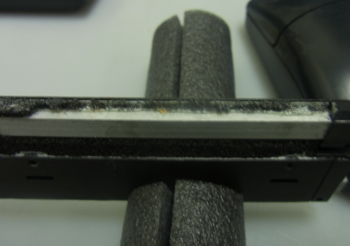
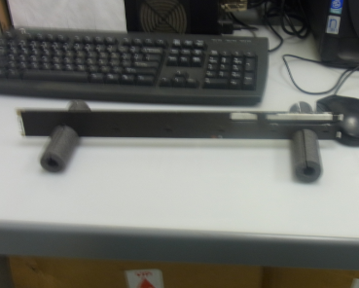
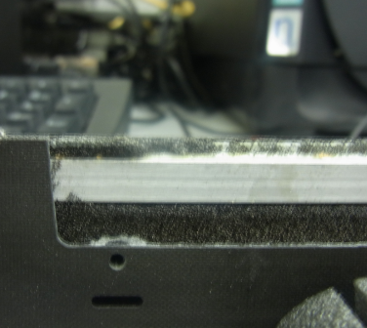
RIM6072
RIM6076
RIM6077
RIM6078
Hubert cut and removed the back carbon sheet (RCC side) of B3L12 and exposed the Al tube.
This is the region where we see strange structure inside of the tube by Machida scope. There are strange yellow spots here and there. So Hubert and I come to VTXlab to see those yellow things by the microscope at the lab

Slide 6
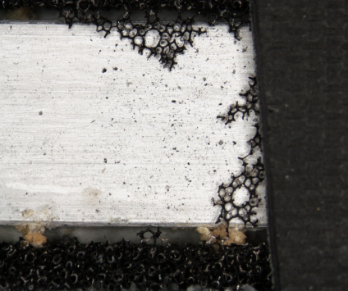
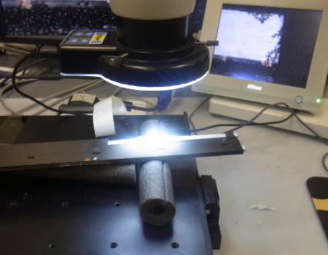
18184356 B3L12 top surface
Start of the scan 2005/05/18 18:43
RIM6081. 2013/1/24 18:23
The time stamp date of the microscope is totally screwed up and it is off by 8 year.
But time of the scope is not so bad and it is similar to that of my camera.
The offset is 20 minutes. My camera’s time stamp has offset of 1:15 from the EST.
So 18:23 (my camera) ~ 17:08 (EST). It seems that both of the microscope’s time and my camera’s time was set to EDT (and then drifted)

Slide 7
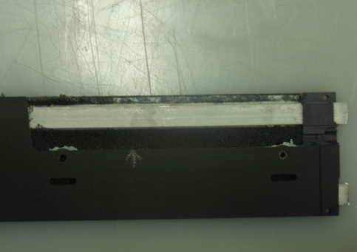
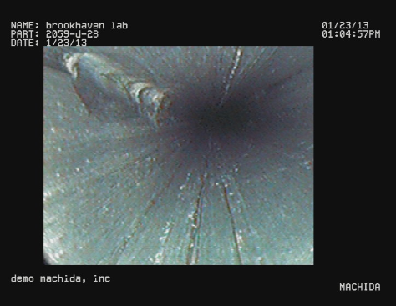
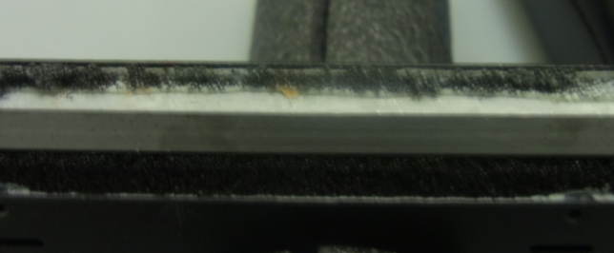
Scan the top surface of the tube
This is B3L12
The arrow points to the approximate position where we saw a strange structure inside of the tube.
One can see several spots that has yellowish stuff

Slide 8
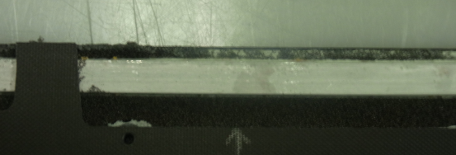
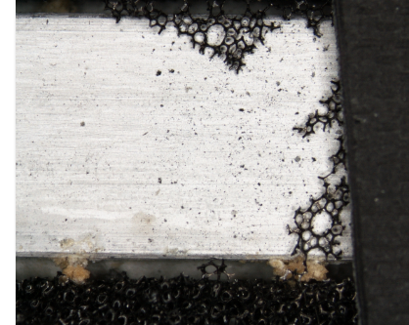
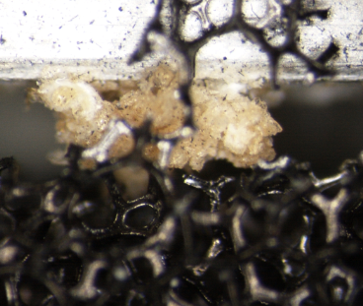
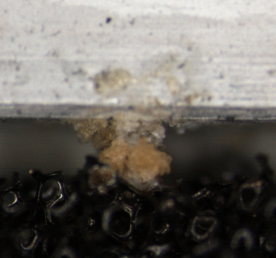
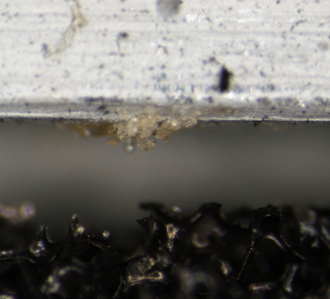
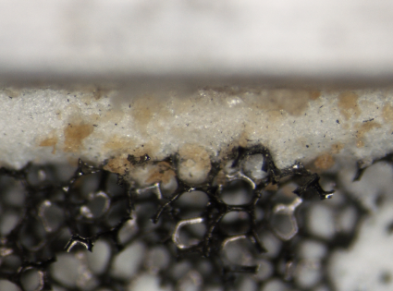
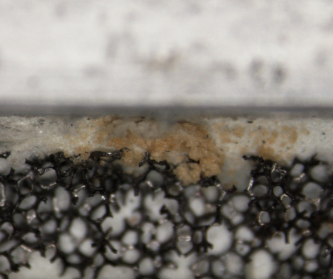

Slide 9
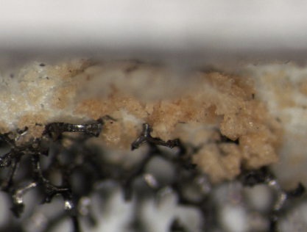
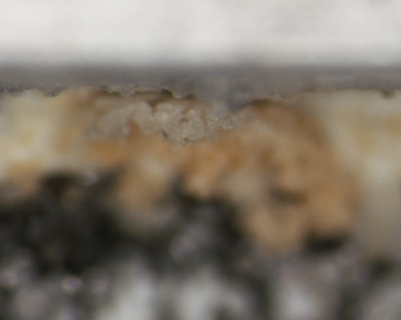
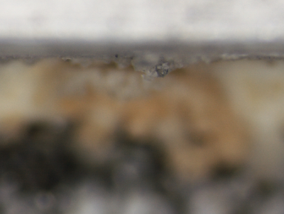
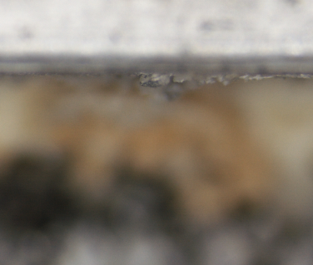
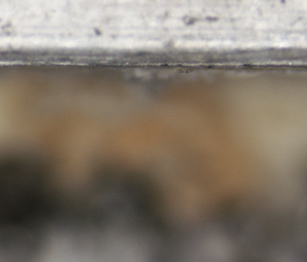
Same stop; different focus (depth)
Something along the side wall of aluminum

Slide 10
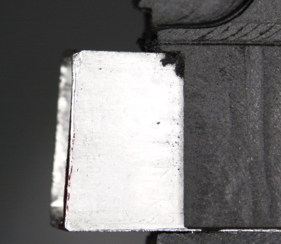
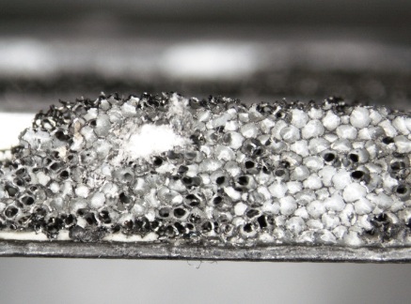
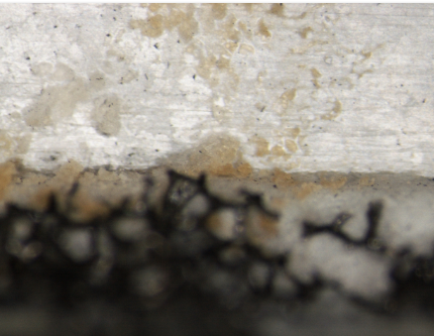
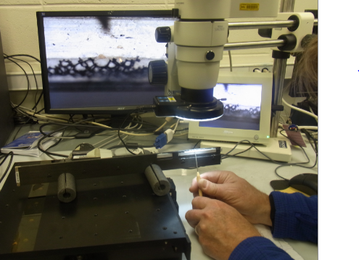
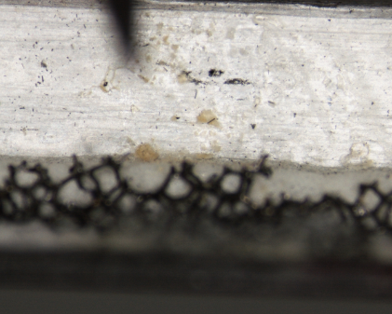
18191703
Start of side wall scan
19:17=18:57 (camera)
18191451 End of top surface scan
Side wall also has the yellow stuff
RIM6089 19:09(camera)=18:54(EST)
18192856 19:28=19:08(camera)
Hubert is pointing the place where we saw the strange feature by Machida scope.
There is something there. RIM6089 and 18192856 was taken at almost the same time

Slide 11
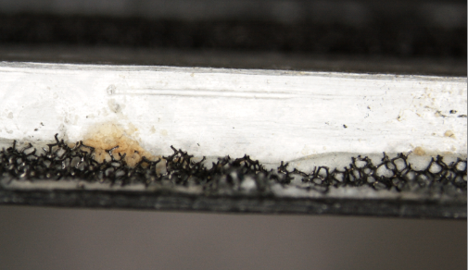
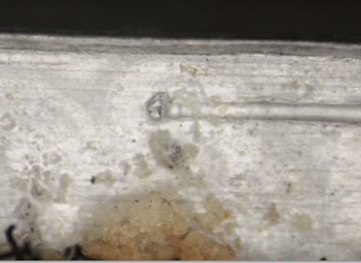
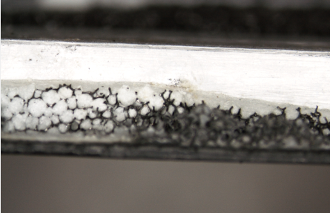
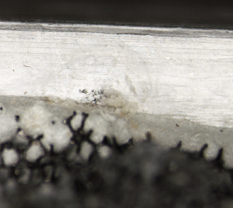
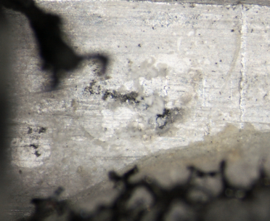
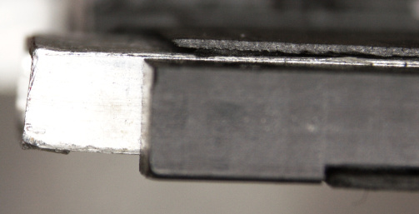
Stronger spot of yellow
Place Hubert pointed in the last page
18192938
Leaking here??
18193638
Is the why stuff glue?
18193941 near end.
Is there hole?
18194335. End of the side wall scan
19:43(microscope)=19:23(camera)=18:08(EST)

Slide 12
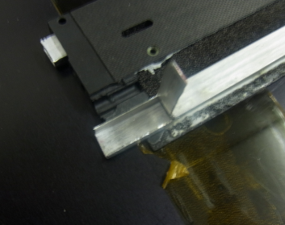
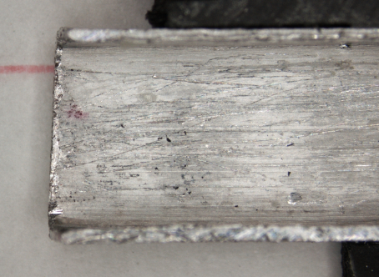
RIM6111 20:09(camera)=18:54 EST
Hubert had opened up the end of the tube
This is the same B3L12, and this is the side we scanned from slide 5
The purpose is to look the beginning of the tube where we saw a lot of scratches in the video scope.
18203305
18203619
A lot of scratches can be seen. We now believe that they were made by the video scope itself. The surface is covered by a very soft stuff that can be easily scratched

Slide 13
18203924…what is these horizontal “black marks”
Actually they are not black.
They shine. It depends on how the light is reflected. These seems to be Aluminum surface.
20:42 microscope time
= 20:22 camera time
= 19:07 EST

Slide 14
RIM6122 20:26 camera time
This is after microscope work. I looked into the tube and see something inside.
So I tried to capture by camra, in vain.
Here seems to be a thin yellowish horizontal line and then some object about 5mm from the bend position.

