Slide 1
VTX leak issue
Hubert van Hecke
The full archive of the investigation can be found at
http://www.phenix.bnl.gov/WWW/fvtx/Mechanics/Cooling/vtx/vtx_leaks.html

Slide 2
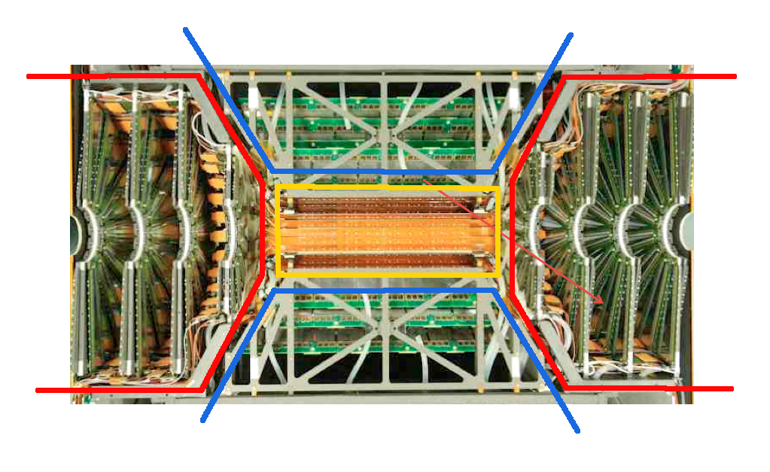
The device
VTX Stripixels
FVTX
FVTX
VTX pixels
VTX Stripixels
FVTX: 2x4 layers of silicon strips
VTX pixels: 2 barrels of silicon pixels (barrels 1 and 2)
VTX stripixels: 2 barrels of silicon stripixels (barrels 3 and 4)

Slide 3
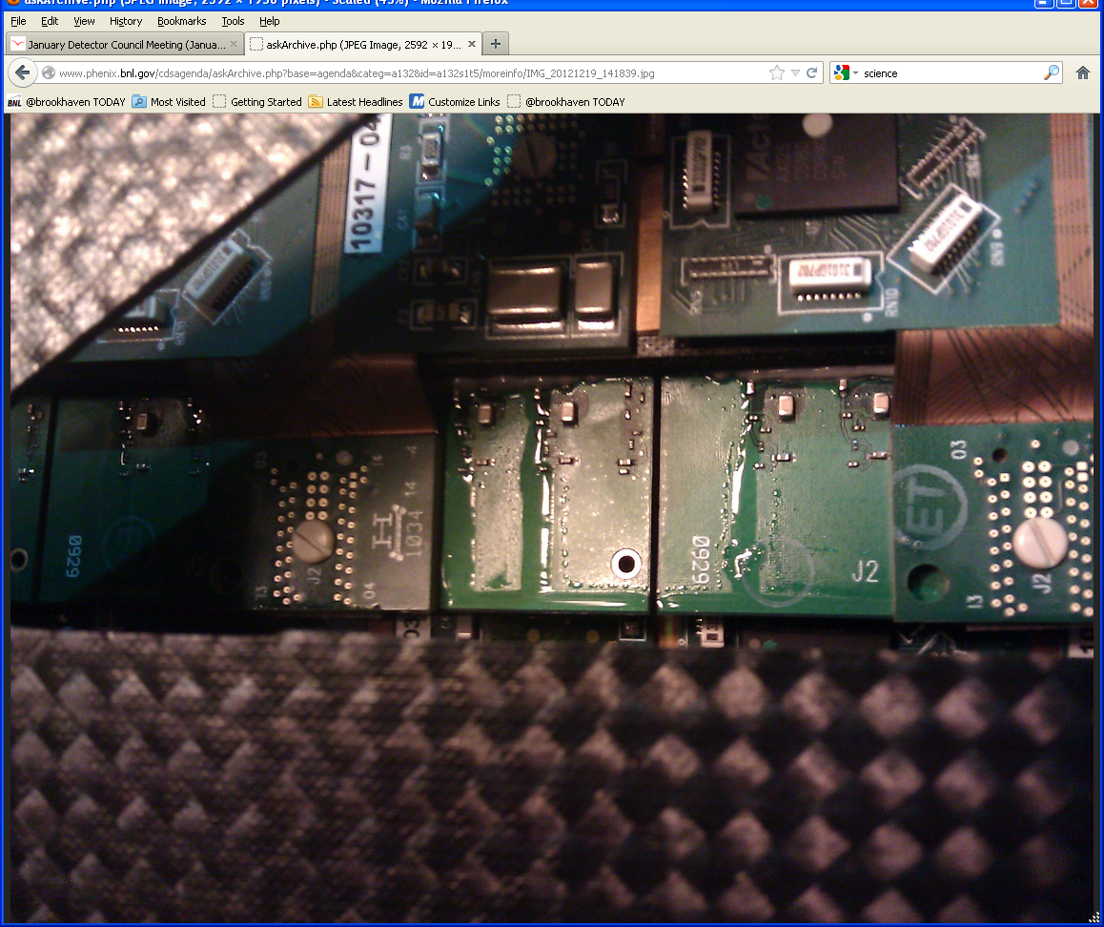
The problem
At the start of operations (Dec 17), massive leaks were observed (~2 gals/day), only in layer 4 (outermost) of the stripixels
Pressure tests were done to establish that the leaks were not coming from the pixels, or from the VTX pixel barrels 1 or 2, or from the FVTX.

Slide 4
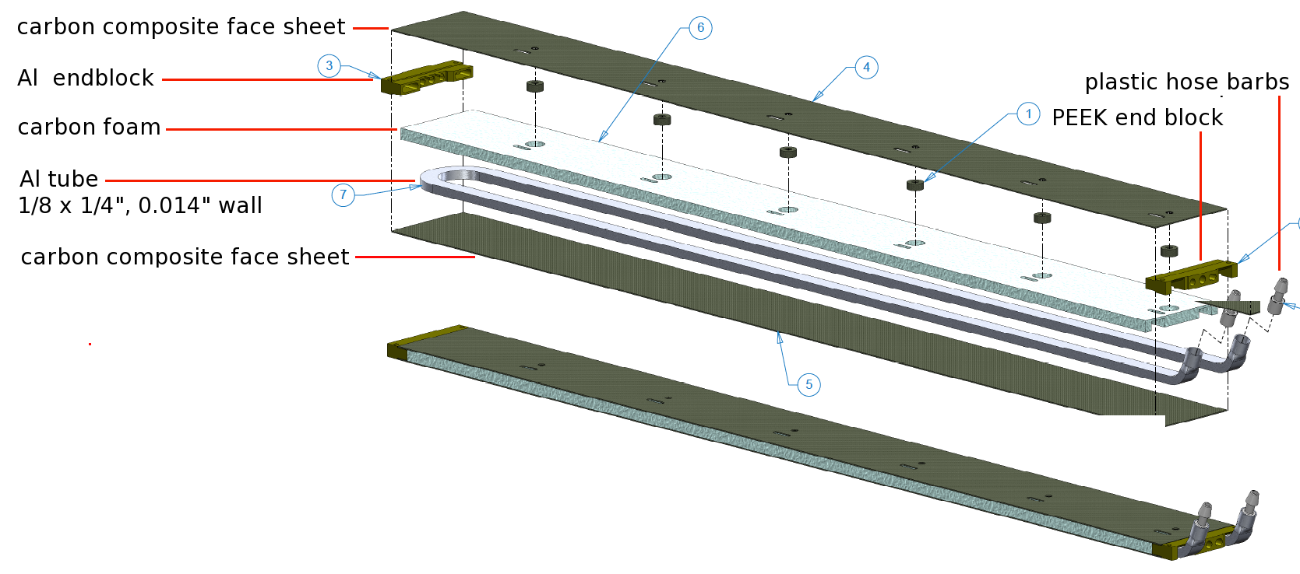

Cooling stave
There are xx staves that make up stripixel barrel 4. Silicon stripixel assemblies are mounted onto these cooling staves (not shown).
Materials:
Tube: 3003–H14 Aluminum
Carbon foam: Allcomp P9 100ppi (“not graphetized at high temperature, but only densified up to .1 g/cc. ”)
Epoxy: Hysol EA 9396, with boron nitride added for thermal conductivity. Applied only to the top and bottom face sheets.
PEEK is a radhard plastic

Slide 5
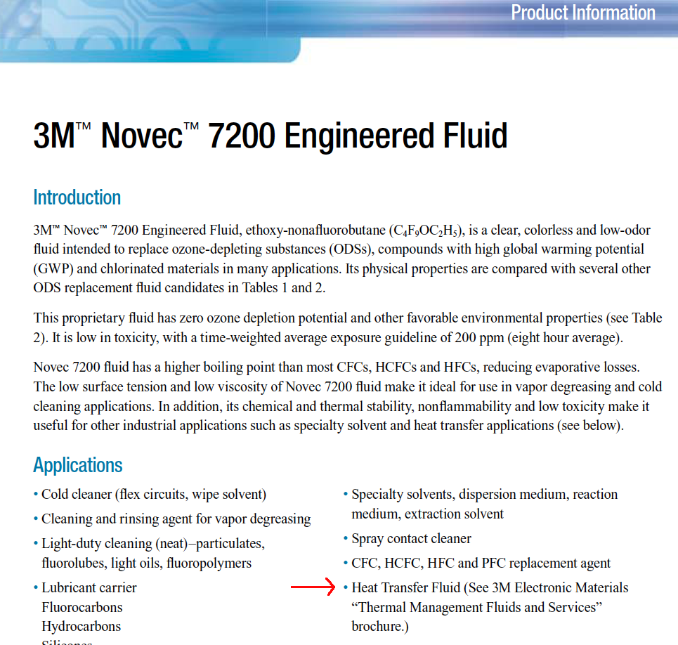
Cooling liquid
Novec 7200, made by 3M
This is a non-conductive, non-corrosive liquid
Density 1.5, shear viscosity ½ of water.
Environmentally benign

Slide 6
Observations
No large leaks were observed in the first 2 years of operation
  Evidence of small leaks was seen in the form of deposits, most near the hose barbs, but some were seen along some stave edges.
Leaks appear to be in the middle of the staves, not the ends
The staves were manufactured in the LBNL composite shop which also made staves of a very similar design for ATLAS.
When the leaks were noticed, a crackling sound (~Rice Krispies) was heard
The exterior of the detector (fiberglass, plastic) was electrically charged
  Discharges had been seen in the past from non-grounded cooling circuit components. Friction and a non-conductive fluid transports charge.
Small modifications had been made to the plumbing
  Lowered the back pressure by 1-2 psi
The cooling channels of the VTX pixels are different (bonded carbon composite sheets)
The cooling channels of the FVTX consist of carbon composite sheets top and bottom, and PEEK sidewalls.

Slide 7
Hypotheses (1)
Pressure spike
  But pressures and temperatures were all normal. Tubes were tested to 125 psi before assembly, and none had failed. Operating pressure is 24 psi max. There is a 38 psi relief valve. Recorded temperatures of the coolant were normal
Abrasion due to foreign material in the coolant
  Analysis of samples showed no foreign content
Contamination of the coolant, difference in coolant from last year
  Analysis (IR spectra) of samples taken from around the cooling system showed all were pure Novec
Static discharge damage
  But to form a large enough spark, there needs to be a big enough gap. The carbon foam that surrounds the Al tubes is a decent conductor, and they are touching. Resistance measurements show ~few Ohms.
Cavitation
  Cavitation can do a lot of damage. Novec has a high vapor pressure. A crackling sound was heard. This sound was not heard last year.
  However, the flow speed is low (1/2m/s), and the dimensionless number that indicates cavitation probability shows we are far from the cavitation regime.
  Cavitation damage should be on the inside, near bends, not in the middle of the staves

Slide 8
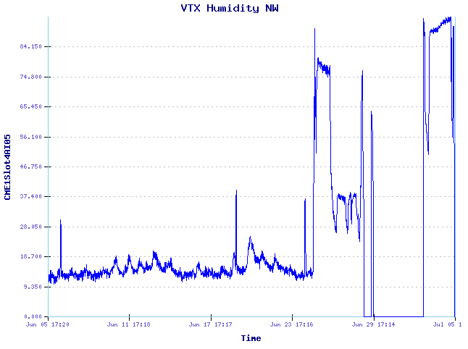
Hypotheses (2)
Corrosion – internal
  Water diffused into the Novec
  Wates solubility in Novec is low (few ppm?), and falls with temperature. Thus water is forced out of solution in the coldest part of the loop (the chiller)
  No water was seen in the analyzed samples
Corrosion – external: Carbon + Aluminum + water
  Where is the water from?
84%
Our logs show that at the end of run 12, after electronics tests were done, the cooling was left running, with the detector in a state that did not provide a good seal to outside air.
For a few days, the humidity inside the detector reached 100%

Slide 9
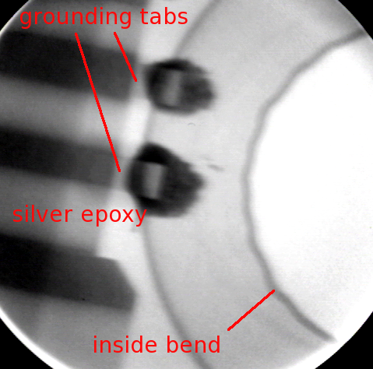
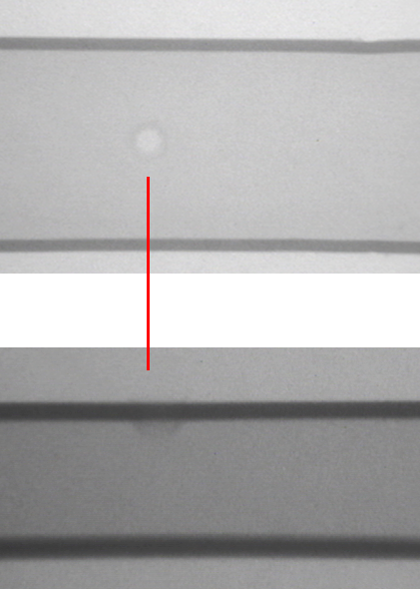
Non-destructive tests – 1: X-rays
X-ray of a tube. This was to establish whether or now we would be able to see a small hole
A spare tube was prepared with a small hole punctured in it
Top view
Side view
A small hole would be undetectable with this technique

Slide 10
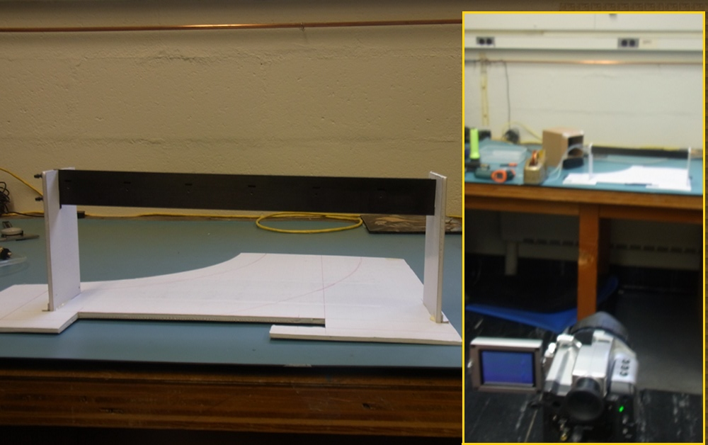
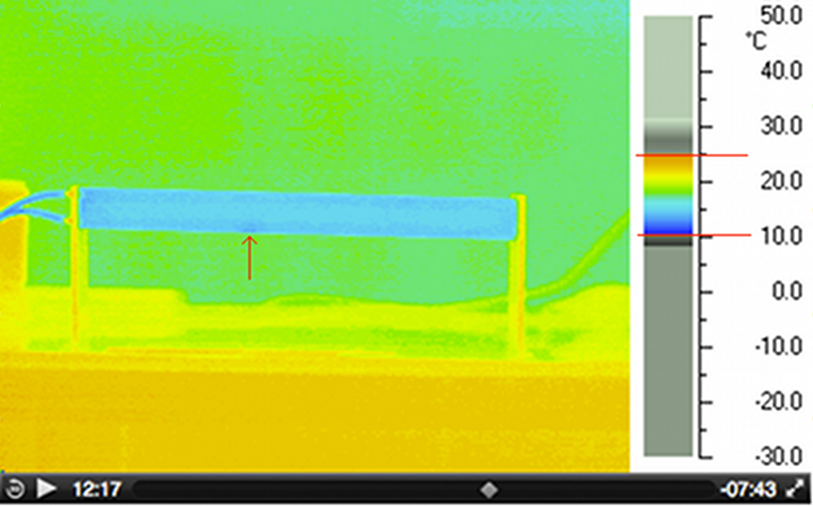
2: Thermal imaging
We set up one of the known leaking staves, and hooked it up to a cooling system
We cycled the coolant, and observed a cold spot during the warm-up phase, as leaked coolant evaporated. This allowed us to pinpoint the leak location

Slide 11
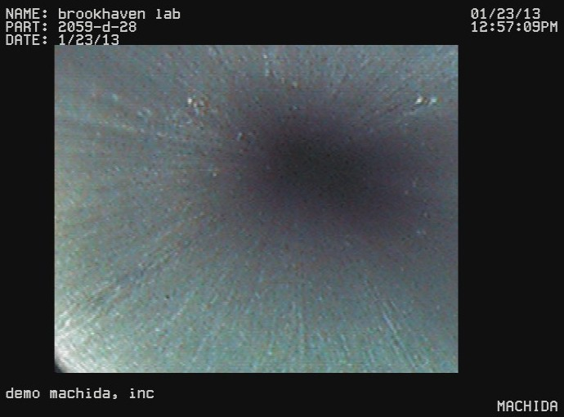
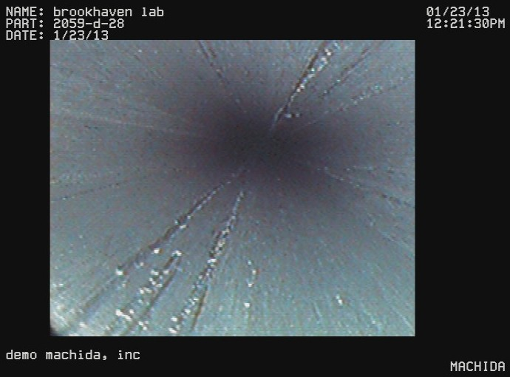
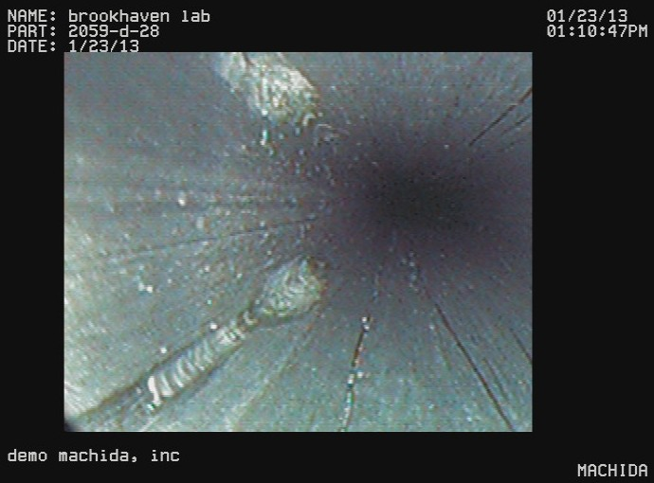
3: Borescope imaging
Machida has a flexible borescope with a 2mm-high camera, 1024x640 px. This is just small enough to slide into the tube.
An unvisited section is pristine
The camera itself scratches the soft Aluminum
In a few places, we saw unusual features.

Slide 12
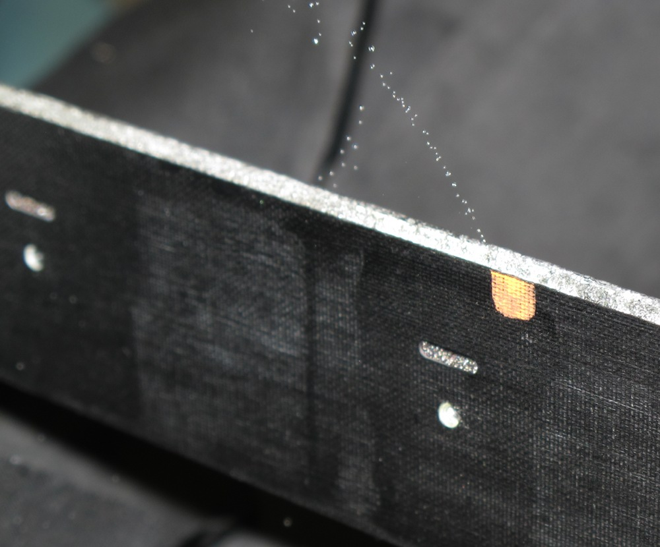
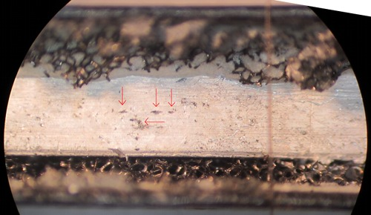
Observation of the leak
With the leak location identified, we removed the outside carbon foam, and saw the leak.
Small craters could be seen

Slide 13
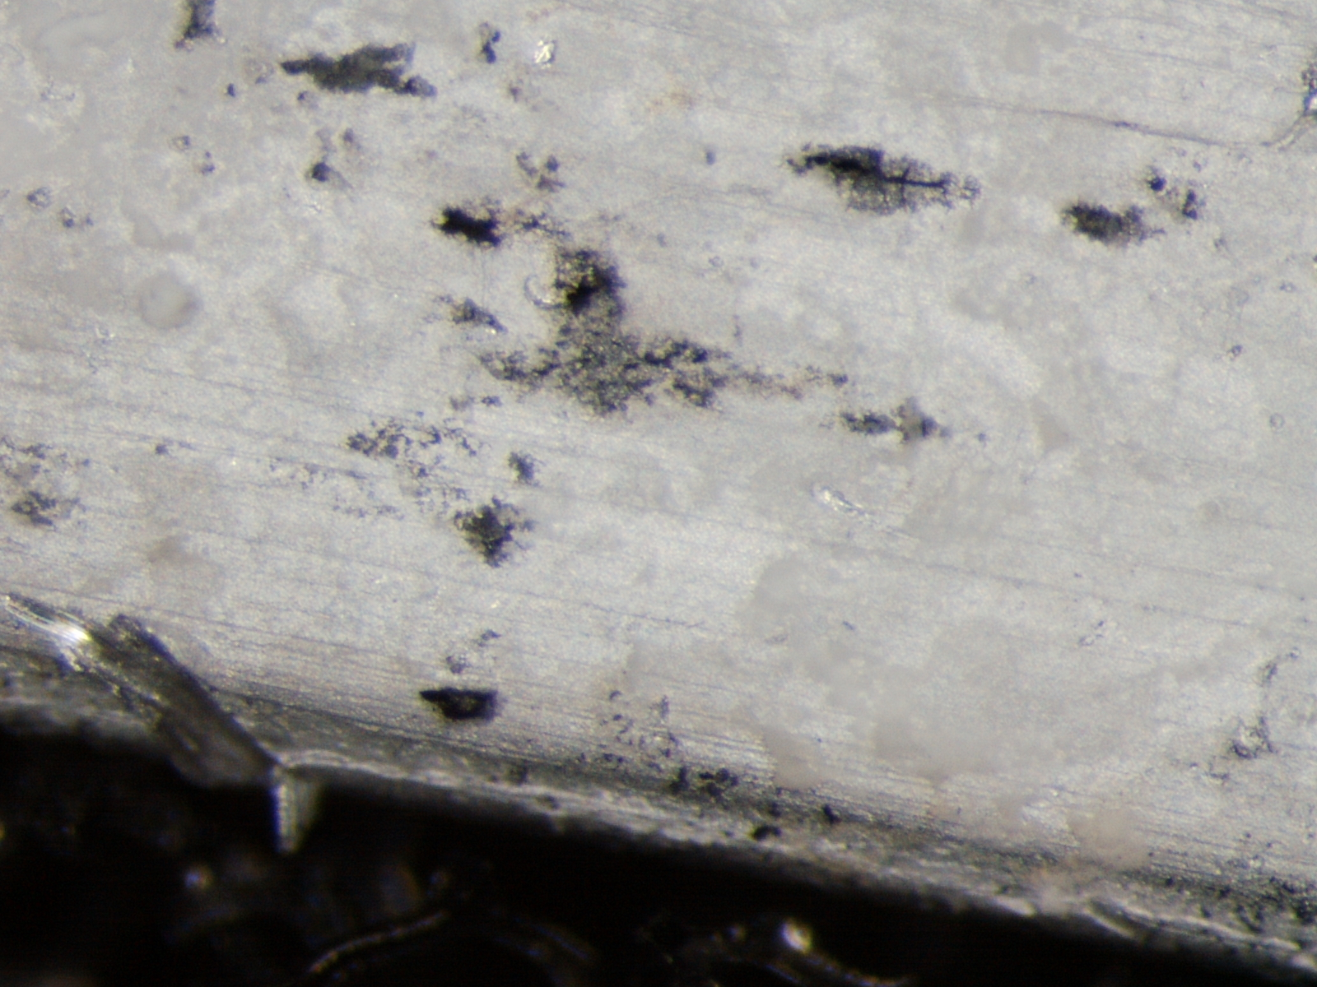
Closeup
Text

Slide 14
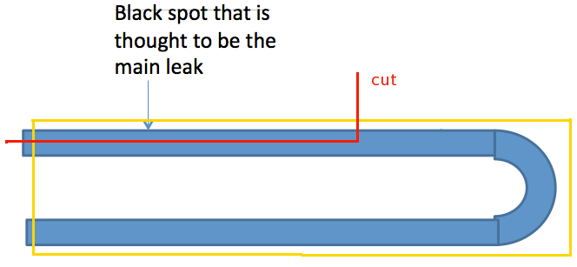
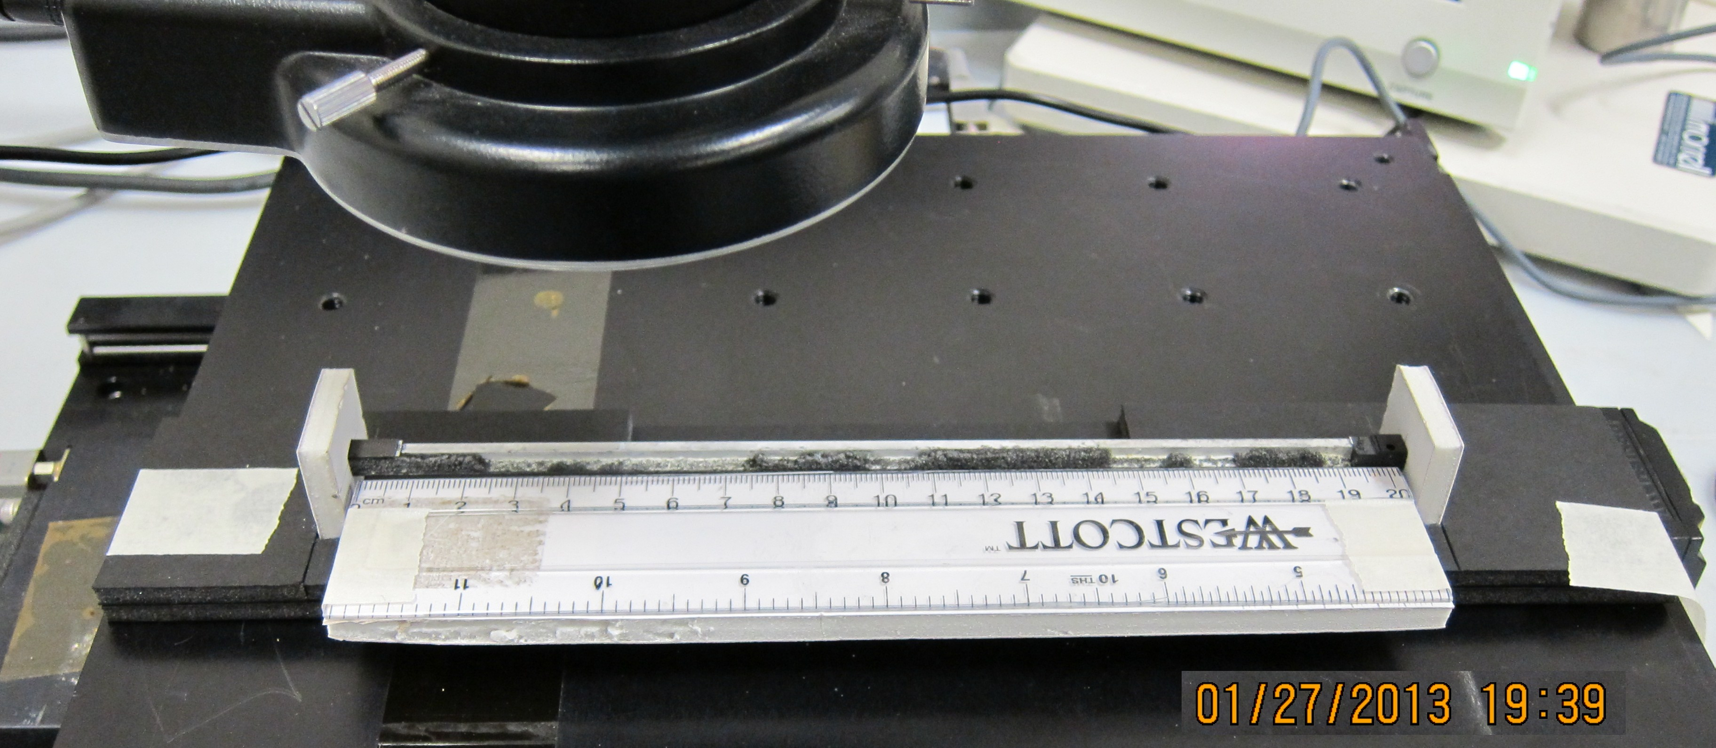
Cutting the tube open
A jig allows a scan of the cut section in 1 cm steps, and registration of front/back/top images
Text

Slide 15
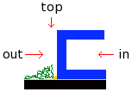
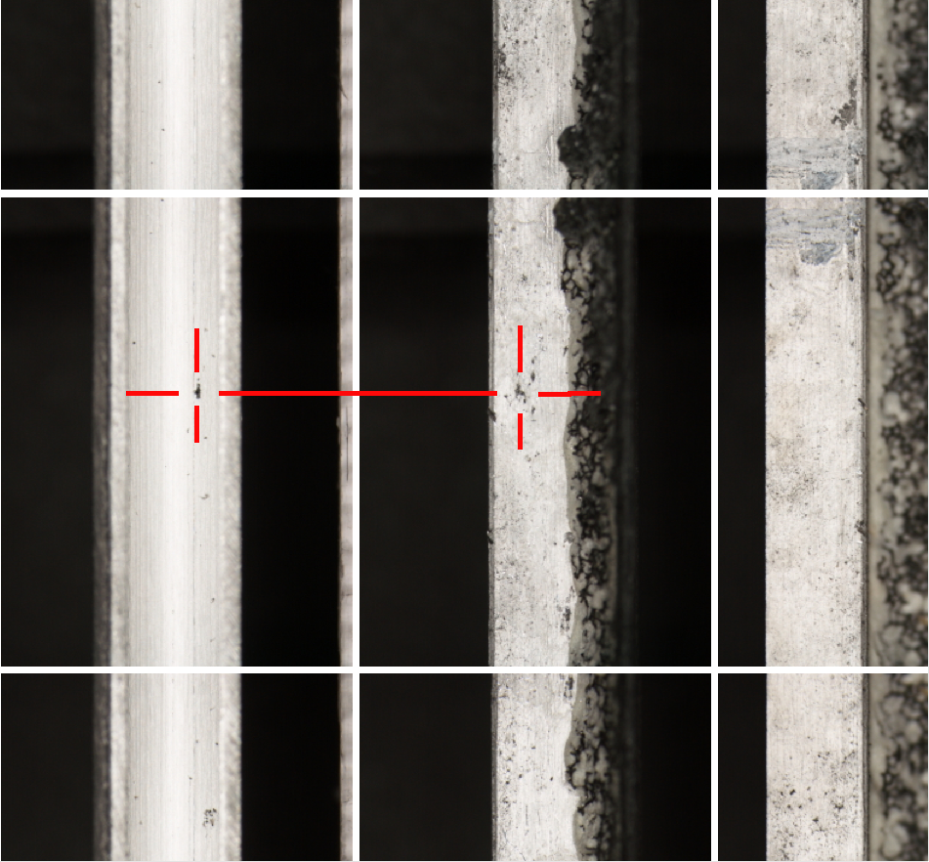
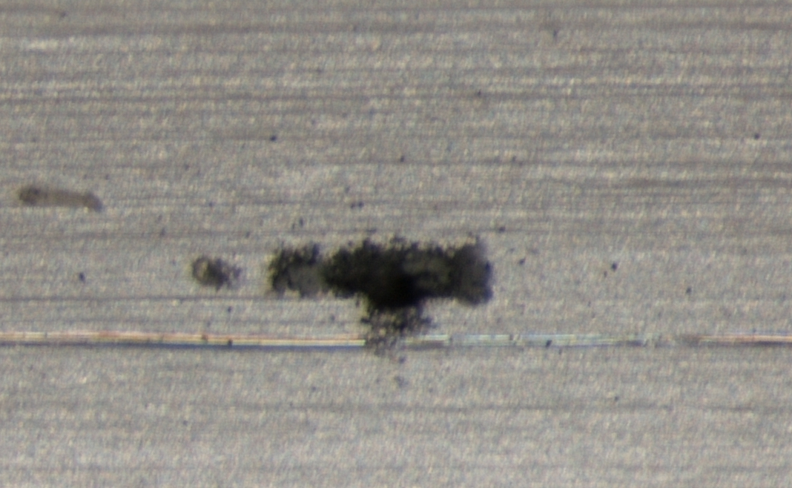
Inside/outside/top views
inside
outside
top
Text
The inside of the tube is very clean, the outside shows signs of corrosion
The leak can be found on the inside of the tube

Slide 16
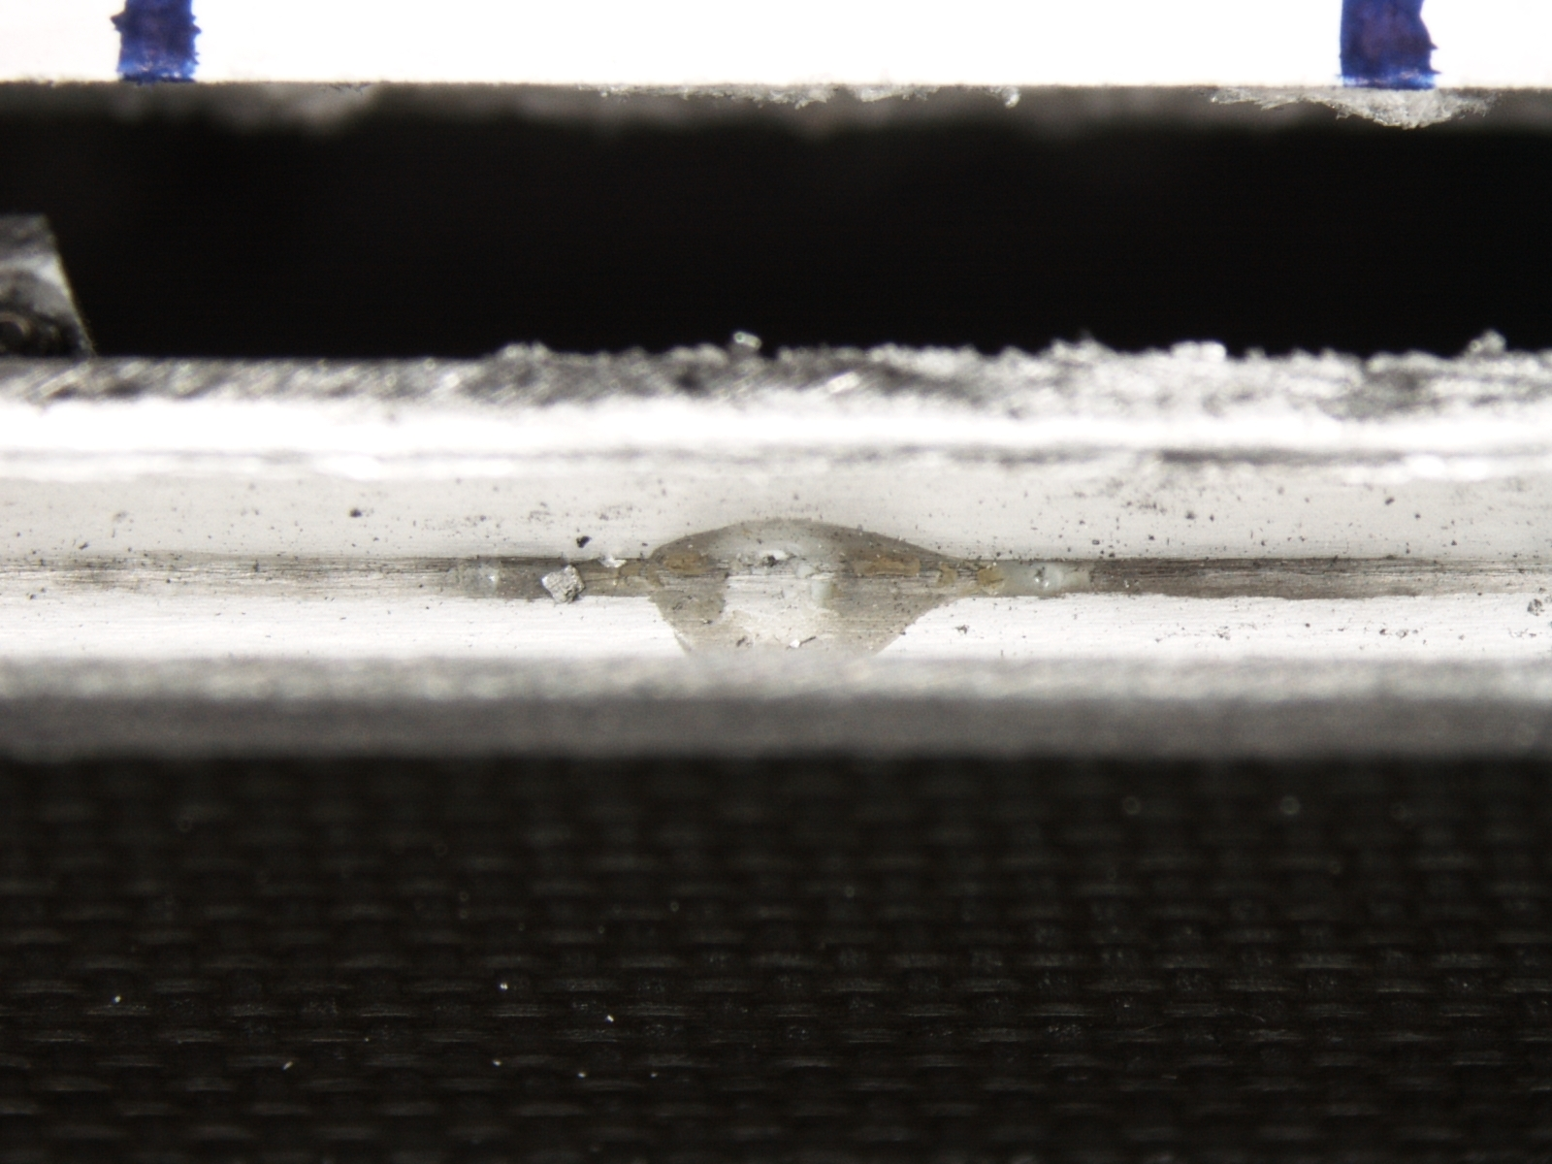
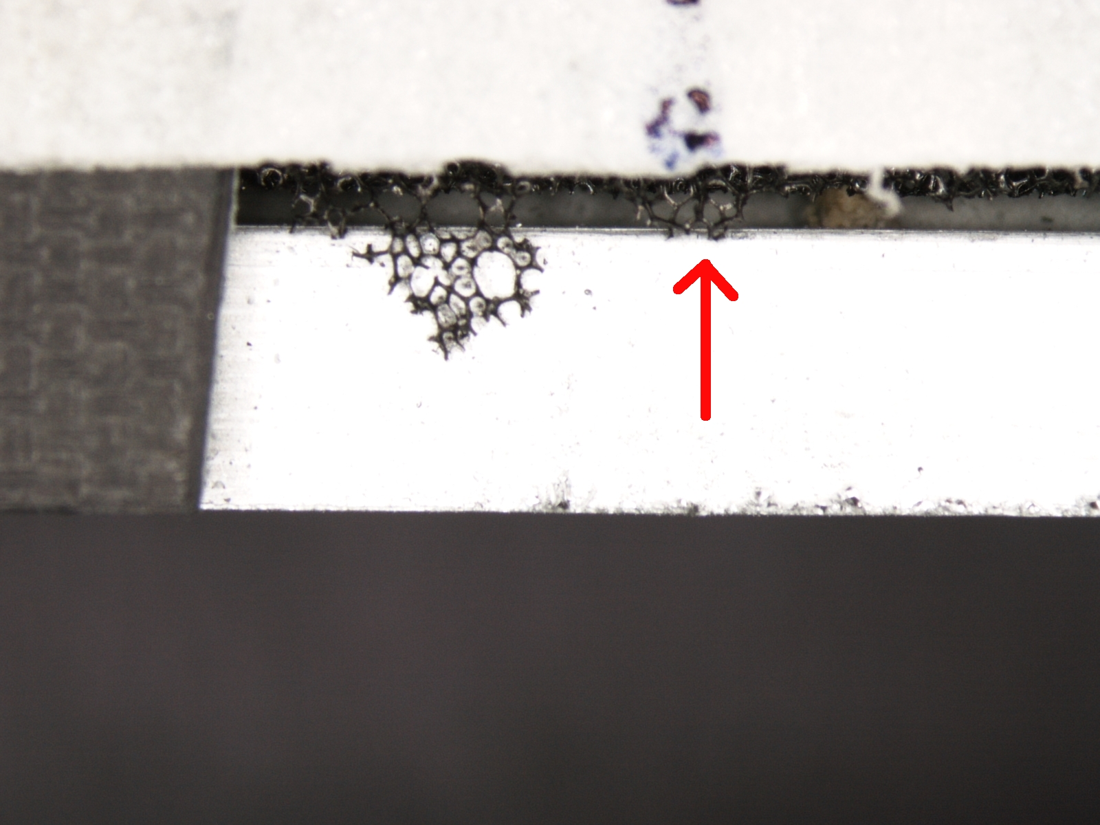
Inside/outside features
Feature seen on the inside corresponds to a location where carbon foam remained attached to the outside

Slide 17
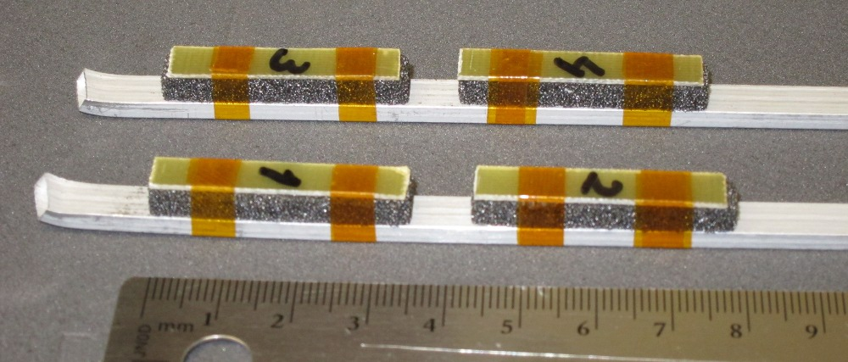
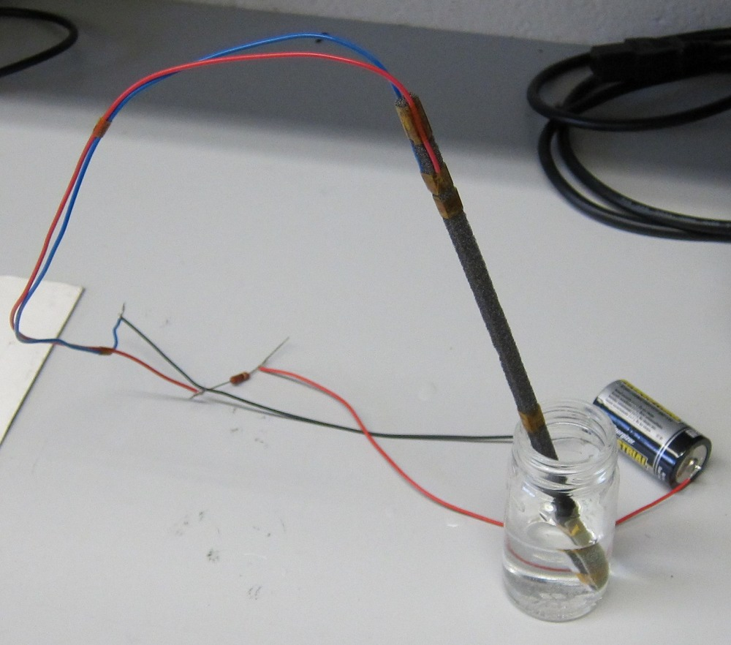
Active corrosion tests - 1
Four carbon foam/Aluminum
sandwiches, immersed in tap water
Text
Aluminum/carbon foam sandwich, immersed in tap water, and assisted by ~30 mA of current

Slide 18
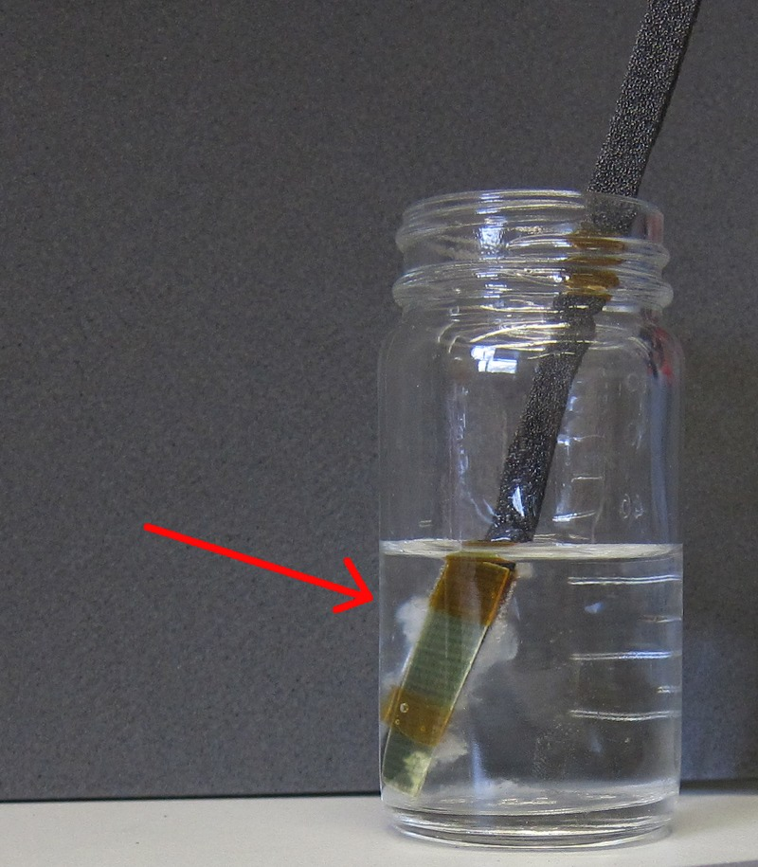
Active corrosion tests - 2
Within a few days, a whitish, very low density material formed at the interface between the Al and C.
I have collected some of this, and it is currently drying so we can send it for analysis.
Text

Slide 19
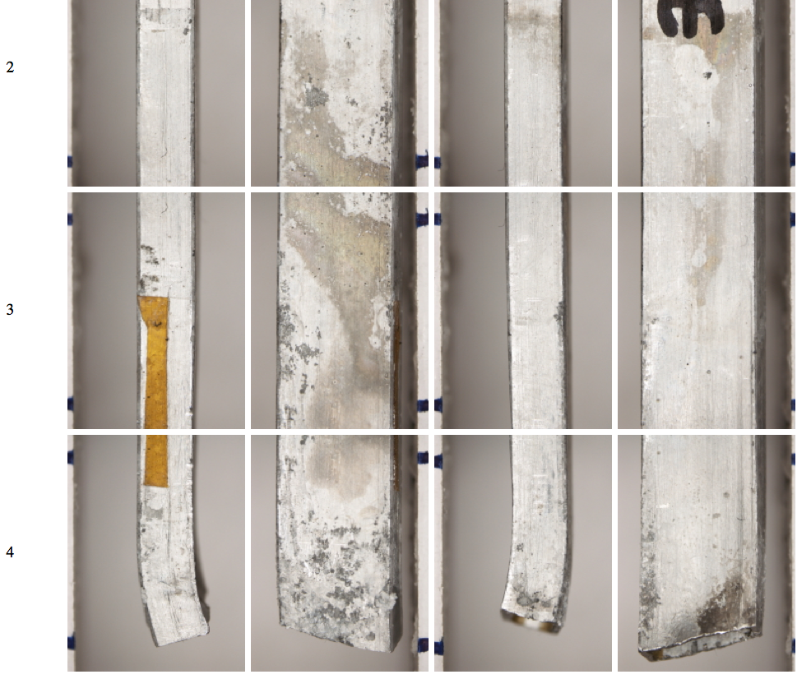
Active corrosion tests - 3
side
Carbon
side
water
After 9 days I removed the samples from the water. The side facing the carbon shows the same discoloration and pitting as seen on the detector staves.
The side facing the water remained relatively clean
Text

Slide 20
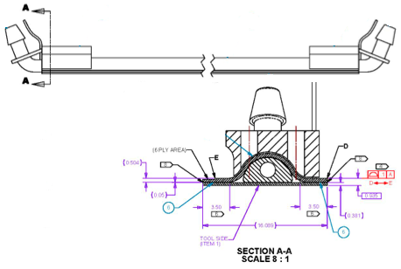
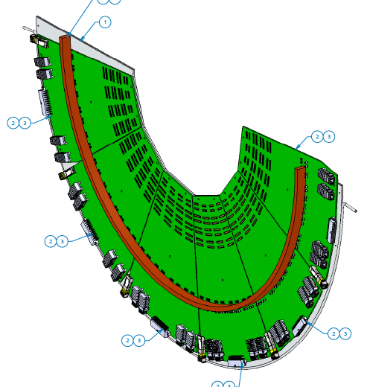
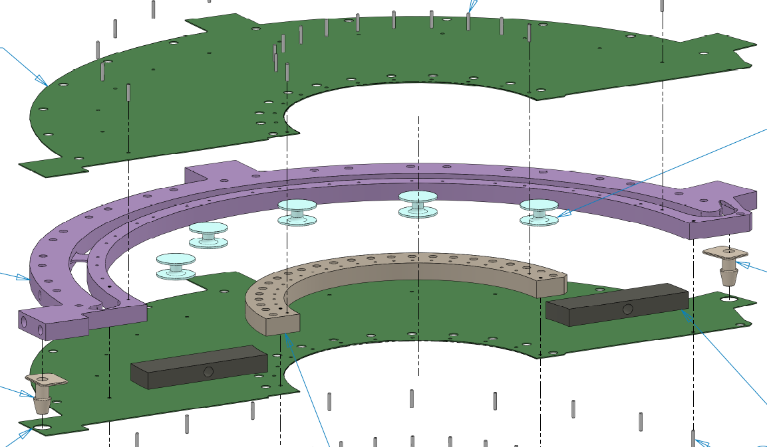
FVTX, VTX pixel cooling
Systems were leak-tested in the IR before removal in January
Tested again in the lab
Tested again after re-installation
Pixels: carbon-carbon
FVTX: ROC cooling plate
FVTX: carbon-PEEK

Slide 21
.
To be done
Analyze the whitish stuff produced in the sample tests
  This is assumed to be Aluminum oxide
Do the SEM/atom probe on the known leak site
  Identify the black material on the inside of the craters
Analyze other residues found
  These are thought to date back to run-12, when plasticized leached out of the cooling system tubing.
Inspect barrel 3
More?
Unanswered questions
Why was only layer 4 affected, and layer 3 showed no massive leaks?
- dry N2 was blown in from 2 small hoses near the center of the detector. Was barrel 4 too far away?
More?
.
Hubert van Hecke - VTX leak issue
21

Slide 22
Conclusions
The leaks were caused by galvanic corrosion between the Aluminum and the carbon foam
No evidence that Novec played a role in the corrosion
Water was introduced to the interface by condensation. Some of this may have already occurred in the first two years, but the events at the end of run-12 caused the sudden massive leaks seen in December
The VTX pixel staves and the FVTX cooling channels are not affected by this effect, and these systems can be safely operated.

Slide 23
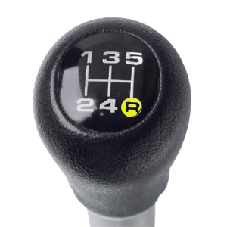
Backup

Slide 24
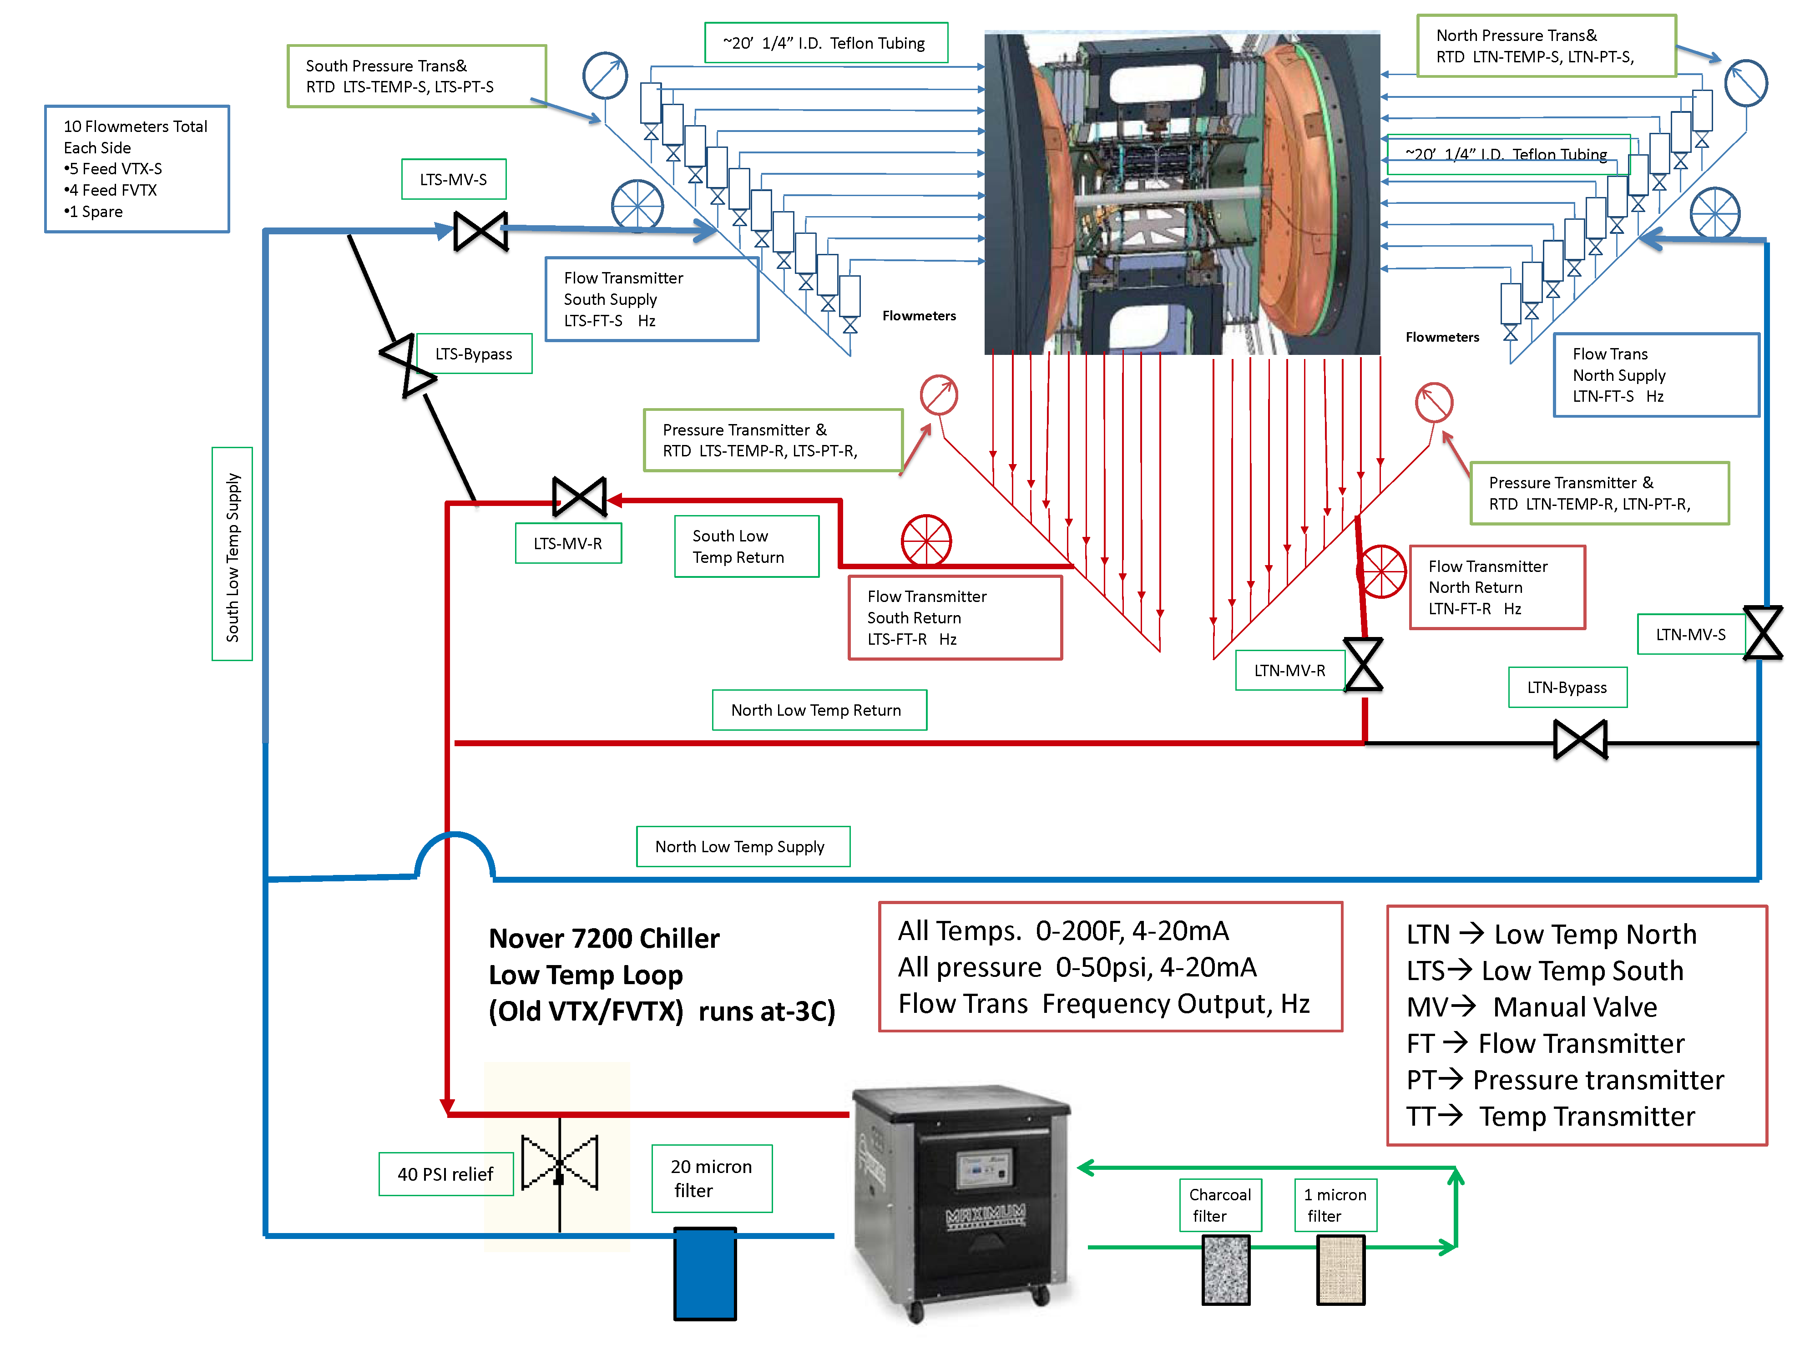
Chiller loops 2013
(more pictures)

Slide 25
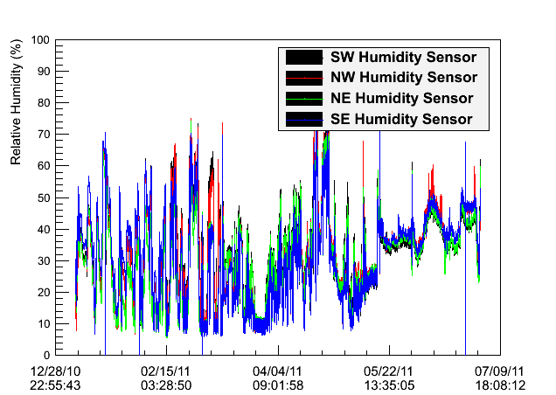
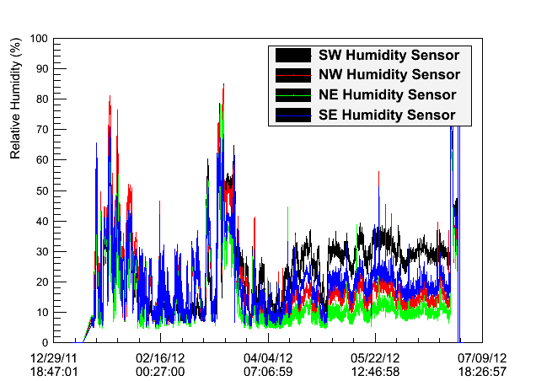
Relative humidity 2010-2012

Slide 26
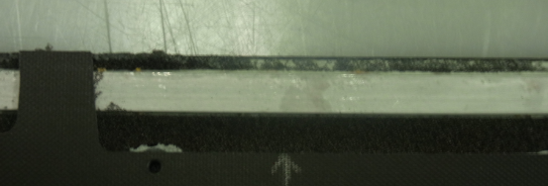
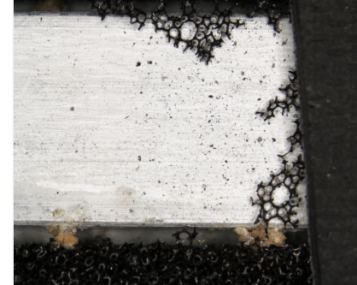
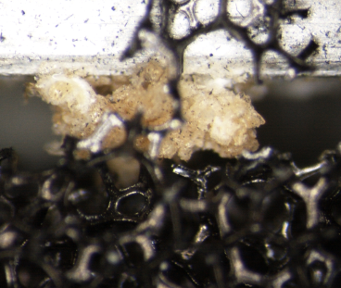
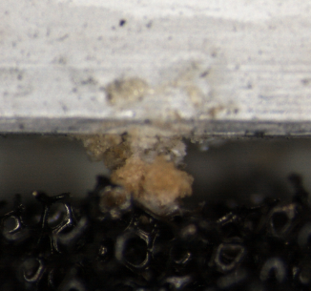
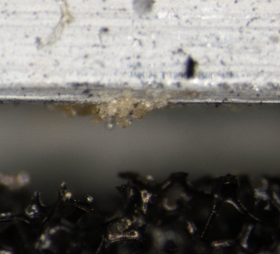
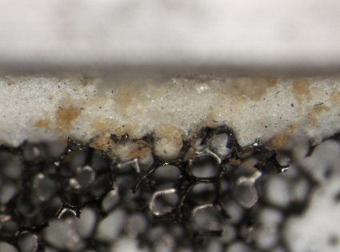
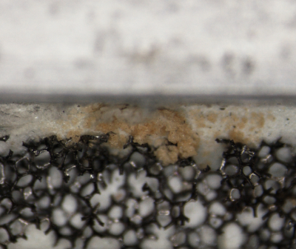
Backup material
Other deposits
(more pictures)

Slide 27
Leak discovery
From Eric:
….. we pressurized the system the system the afternoon of Dec 17 and did not observe any visual leaks. The system was pressurized over night and in the morning of Dec 18, we noticed an ~2gal drop in the coolant level. By the end of the day (12/18/2012) we isolated the problem to one cooling loop on B3 West but there was no indication of a leak in the east detector. The B3 West loop was closed off and the balance of the system was pressurized with Novec for the night. On Dec 19, it was discovered that there was a leak in the east strip loops. Jimmy, Mike and Rob of course are the experts on this.

Slide 28
Backup material
(more pictures)

Slide 29
Backup material
(more pictures)

