Slide 1
Analysis of Metrology Data from First Two Small Disks
Stephen Pate

Slide 2
Metrology Data Quality Analysis
Compare measured positions of reference marks to design positions: two steps
  Global translation & rotation to best match design positions (“global fit”)
  Local translation & rotation of each wedge, to take into consideration small misplacements (“local fit”)
  The size of local misplacements should be consistent with the mechanical tolerances of holes, screws, etc.
  The residuals remaining after the local misplacements are taken into account should reflect the measurement errors in the CMM.
Compare length of each sensor to known length; could measure non-flatness of the sensor (i.e., is each sensor parallel to the plane determined by the three survey pins?), but only if data are sensible.

Slide 3
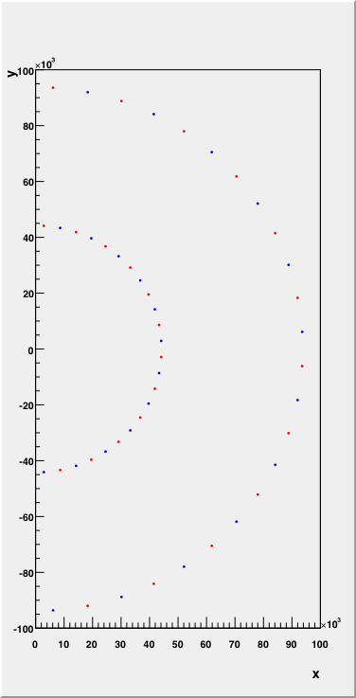
Design Locations
For small disks can only use the two center reference marks
The inner one is located 44000+200=44200 microns from the center
The outer one is located 44000+49785=93785 microns from the center
There are 24 wedges, spaced by 7.5 degrees
Red is upstream
Blue is downstream

Slide 5
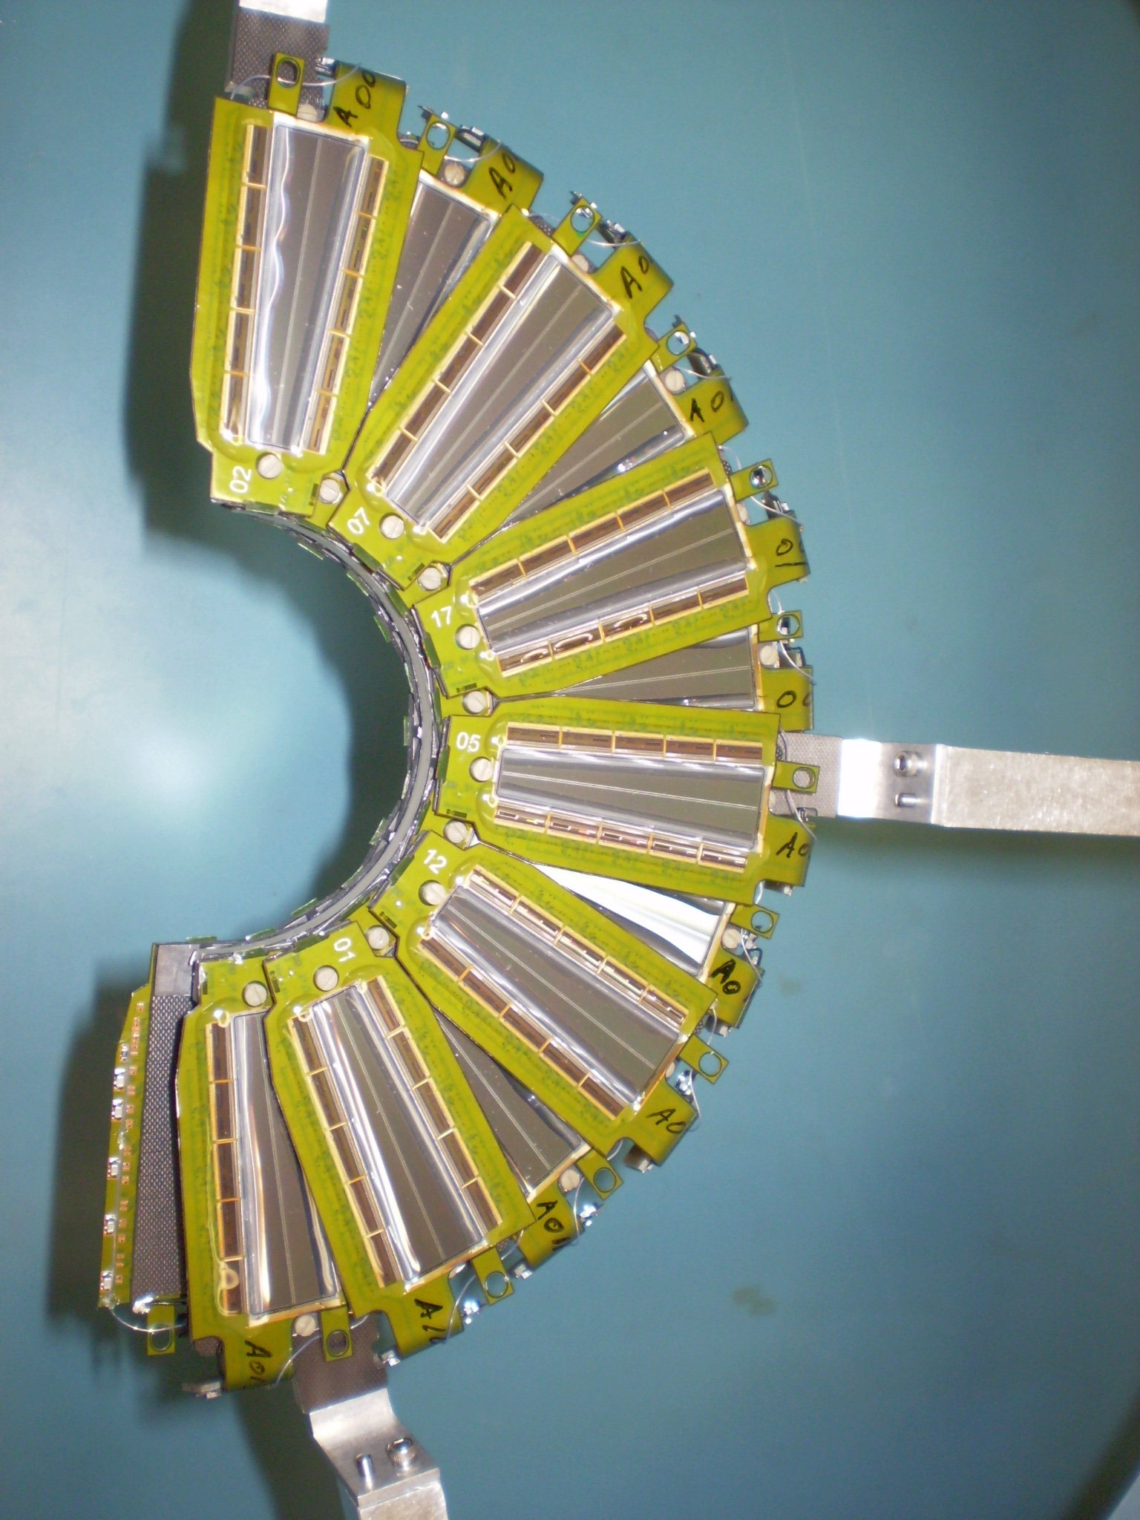

Slide 6
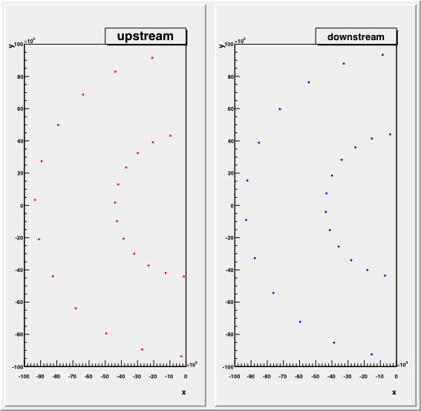
Measured Data
“Station 1 NE”

Slide 7
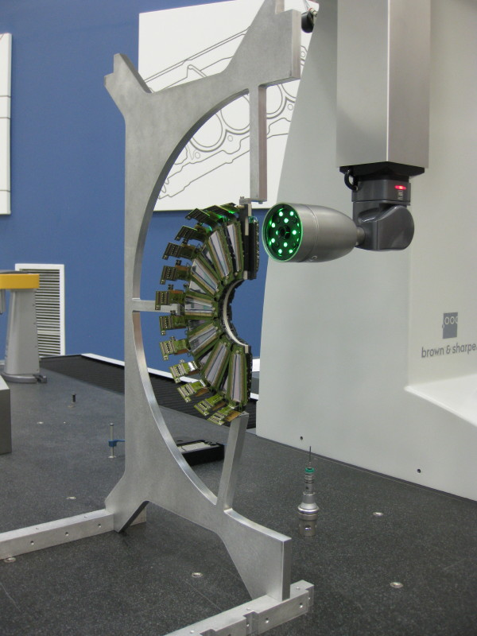
Question about “Station 1 NE” orientation
The “Station 1 NE” disk was oriented like this (correctly!)…
…so I don’t understand why the data ended up rotated by 180 degrees. ???

Slide 8
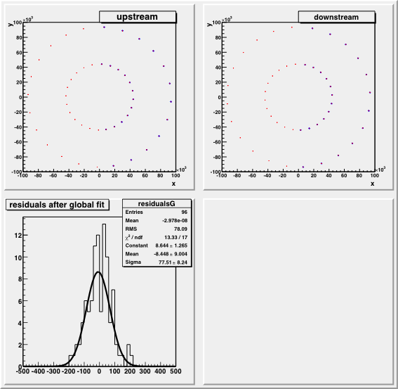
St1NE Global Fit
All of the measured points are rotated and translated together to best fit the design locations.
Blue=design
Red=measurements
Using un-weighted chi-square; I do not assume I know what the CMM errors are yet.

Slide 9
Local Fits
Each measured wedge is now allowed to rotate/translate individually to better fit the design locations. This step directly measures the sizes of “misplacements” that occurred during assembly, as allowed by mechanical tolerances.
Expectations for mechanical tolerances:
size of screw hole in pedestals: 2.69 mm
diameter of #2 screw: 0.086 inches = 2.18 mm
➔ difference is 2.69 mm – 2.18 mm = 510 µ
distance between pedestals holes: ~ 50 mm
➔ rotation angle could be 510/50000 ~ 10 milliradians

Slide 10
Local Fits
We are fitting two measured (x,y) locations to two design (x,y) locations, using three parameters; this means the fit has one degree of freedom.
The fit will center the measured reference marks with respect to the design reference marks; that’s the only degree of freedom.
Δx, Δy, φ
24 fits like this are performed.

Slide 11
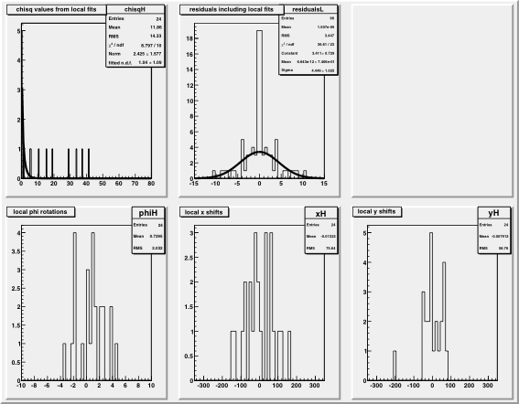
St1NE Local Fits
The distribution of the rotations shows a full range of ~9 milliradians.
The distribution of the translations shows a full range of about 350 µ.
All of that is consistent with expectations.

Slide 12
Sensor Length and Flatness
Are the sensors parallel to the plane formed by the three survey pins?
Look at the measured distance s’ between the two reference marks on each sensor, and compare this to the known distance s.
For the small sensors, s = 49585 µ.
Sensor length s
d
θ
Measured projection of sensor s’
But first, examine the distribution of differences s’ – s. This should be a distribution near 0, perhaps with a tail on the negative side.

Slide 13
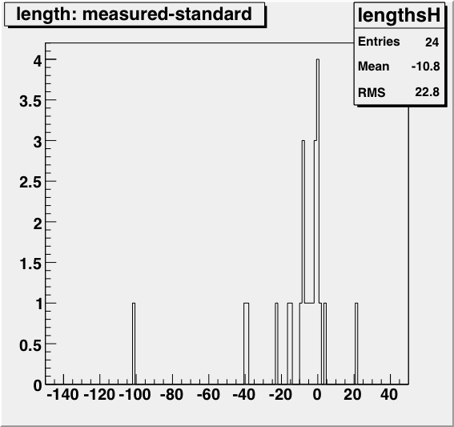
St1NE Sensor Lengths
The largest observed deviation is -100 µ.
That is a non-flatness of 63.5 milliradians, and a lift of d = 3.15 mm. (!!!)
This is not really possible. Hexagon is aware of this problem.

Slide 14
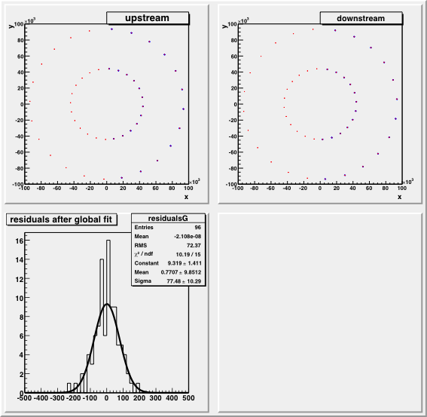
St1SW Global Fit
Similar to results for St1NE disk.

Slide 15
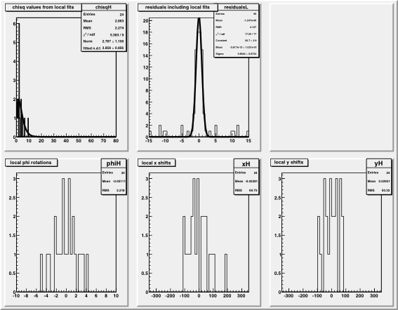
St1SW Local Fits
The distribution of the rotations shows a full range of ~9 milliradians.
The distribution of the translations shows a full range of about 300 µ.
All of that is consistent with expectations.

Slide 16
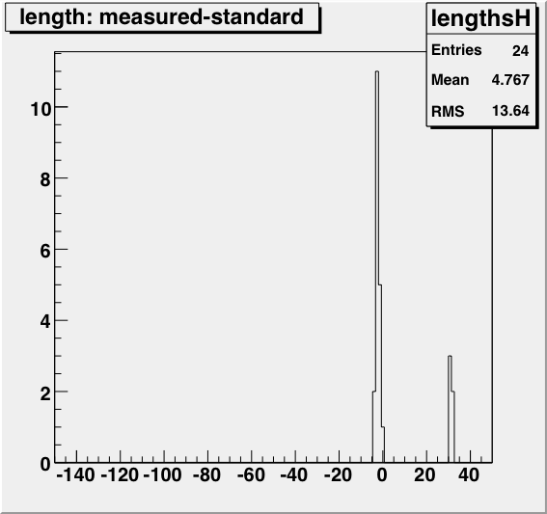
St1SW Sensor Lengths
This is even stranger. It shows a cluster of 5 sensors that are distinctly too long, and all by the same amount, about 30-32 µ.
This cannot be caused by non-flatness! Hexagon is working to resolve this problem in reporting values from their camera measurements.

